Slide 1
USM3D-ME Simulations for DPW-VII: Expanding the Envelope
Brent Pomeroy Mohagna Pandya NASA Langley Research Center Configuration Aerodynamics Branch | Boris Diskin National Institute of Aerospace
Taylor Kate Boyett NASA Langley Research Center Intern, Configuration Aerodynamics Branch Senior, Georgia Institute of Technology
CFD Drag Prediction Workshop VII: Expanding the Envelope 2022 AIAA Aviation Forum June 25-26, 2022

Slide 2
Outline
USM3D-ME Overview
Grids and Computational Methodology
Selected Cases
Case 1a: Grid Convergence Study for Re=20 million
Case 2a: Alpha Sweep for Re=20 million
Case 3: Reynolds Number Sweep

Slide 3
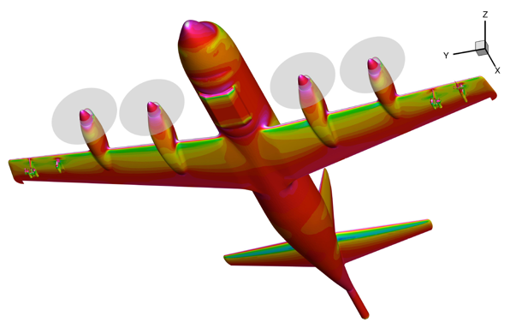
USM3D-ME (TetrUSS Flow Solver)
Builds on rich legacy of USM3D tetrahedral grid flow solver
Cell-centered, finite-volume, mixed-element, unstructured-grid flow solver
Euler and RANS equations with second-order spatial accuracy
Spalart-Allmaras (SA) turbulence model (standard, negative, RC, and QCR2000)
Upwind spatial discretization for mean flow inviscid flux
Cell gradients using Green-Gauss method and nodal solutions
Options for flux functions: FDS, HLLC, LDFSS, FVS, HLLE, etc.
Cell- and face-based gradient limiters: Barth-Jespersen, Venkat, van Albada
Second-order diffusion; face-gradients based on Mitchell’s method
P3-Orion
Courtesy Craig Hunter (NASA LaRC)

Slide 4
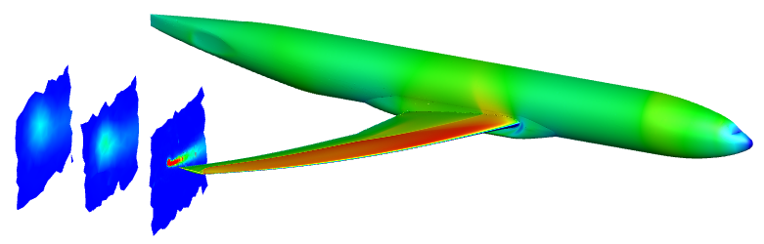
USM3D-ME (TetrUSS Flow Solver)
Standard and specialized boundary conditions
Force-term approach for simulation of propellers and other applications
Time integration
Steady state with local time-stepping
Second-order BDF2 for temporal accuracy
Rigid-body 6-DoF motion support
Parallelized using MPI paradigm; excellent scalability
Nonlinear iteration methods
Preconditioner-Alone (PA); baseline solver technology
Hierarchical Adaptive Nonlinear Iteration Method (HANIM); stronger solver for improved robustness and efficiency; automatic update of CFL
CRM Wing/Body
AIAA 2013-2541, AIAA Journal, 54(9) 2016, AIAA Journal, 55(10) 2017, AIAA 2019-2333,
AIAA Journal, 59(8) 2021, AIAA Journal, 59(11) 2021

Slide 5
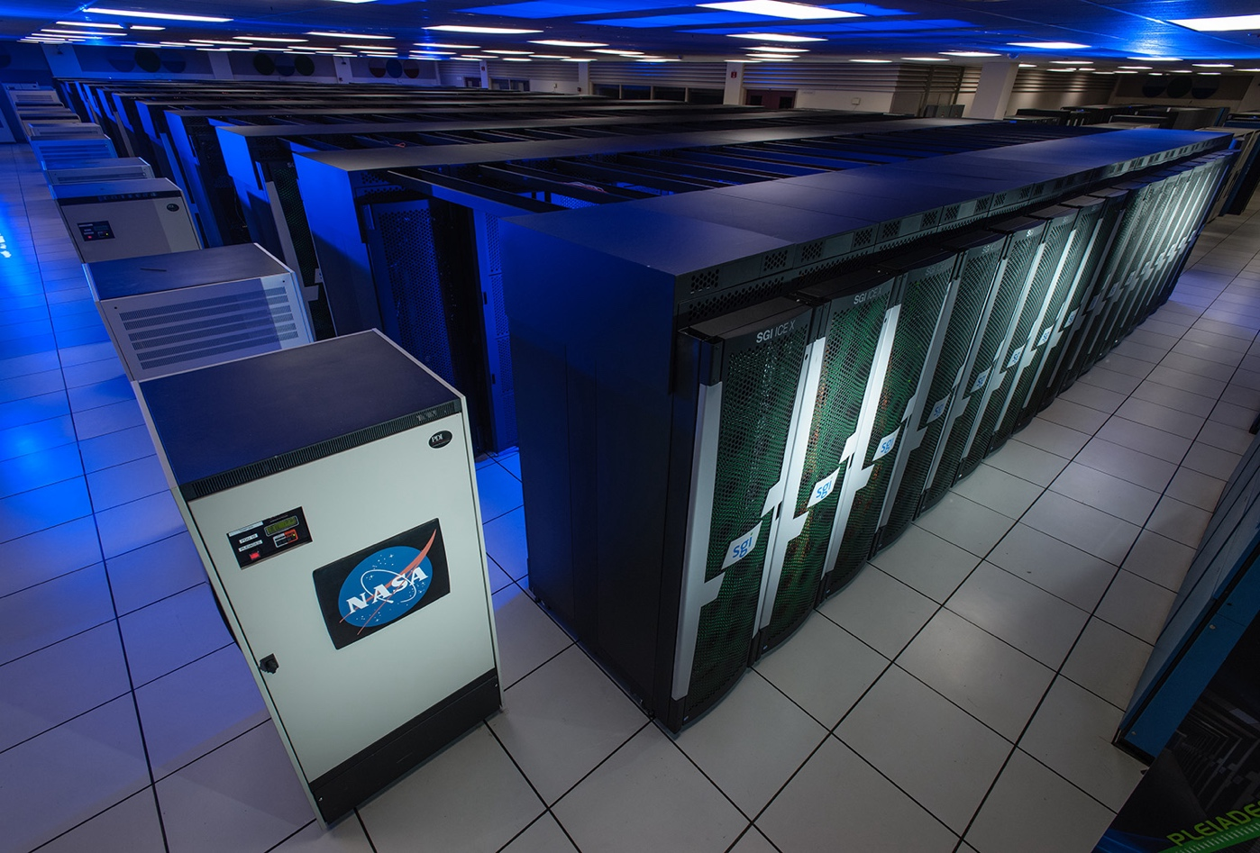
Compute Resources
NASA Advanced Supercomputing (NAS) facility
Located at NASA Ames Research Center
More than 11,000 nodes and 241,000 compute cores
Intel and AMD chips
TOSS3 operating system
Resource usage for DPW-VII
IvyBridge (Intel) chips
Between 600 and 2,500 processors
Medium cases run on 600 processors
Walltime totaled a few hours, depending on the grid and convergence criteria

Slide 6
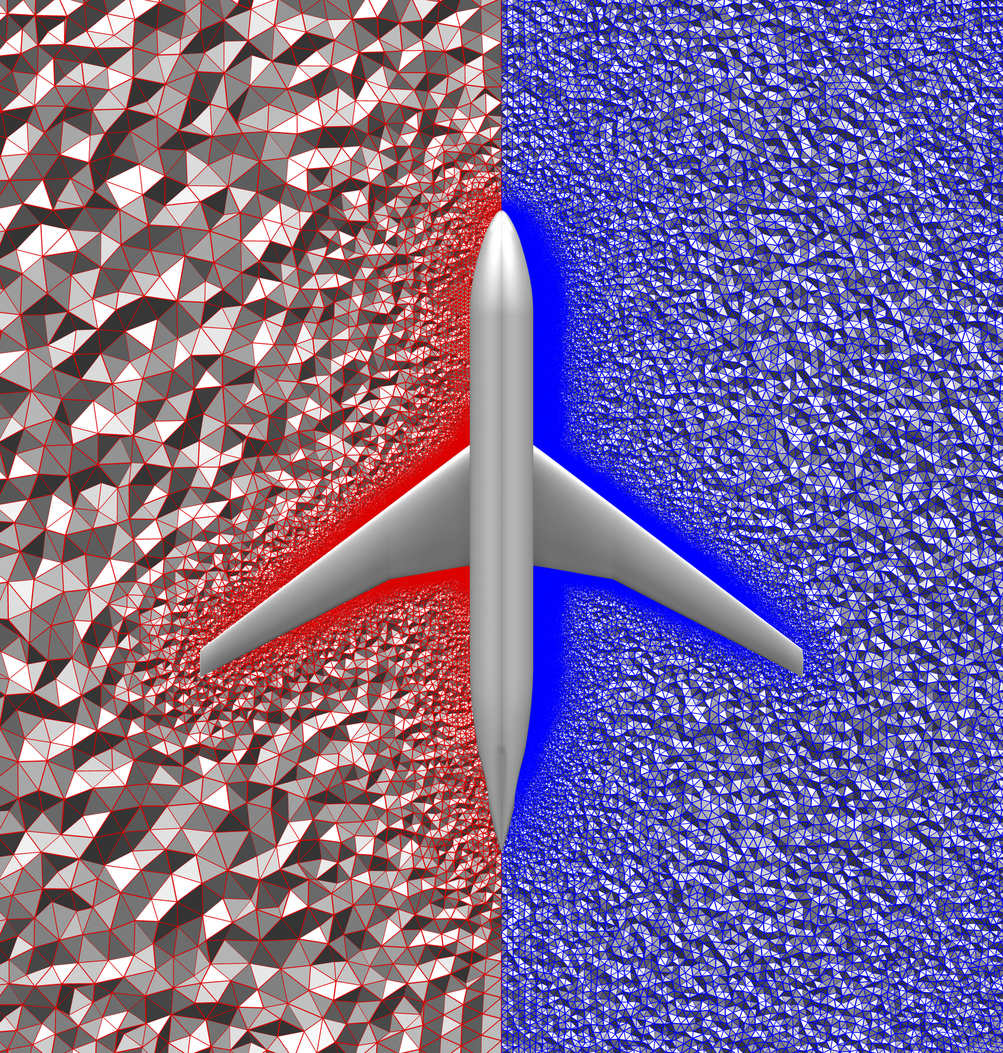
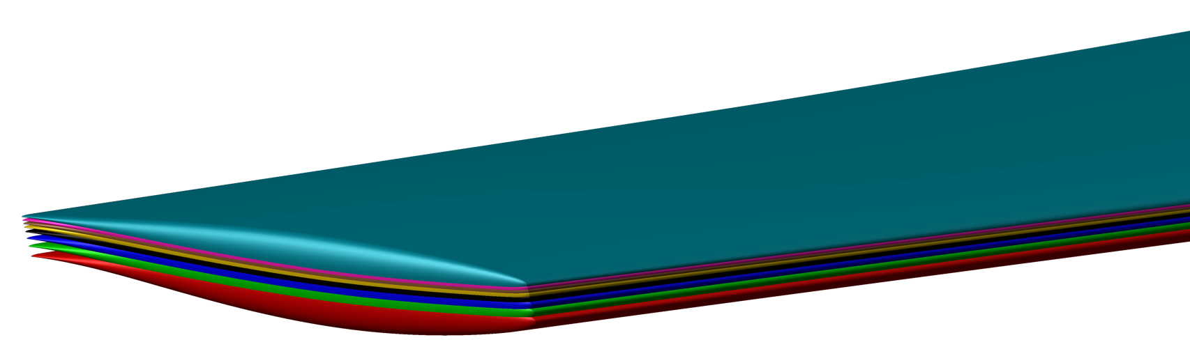
Grids
Used mixed-element JAXA-supplied grids
Grid convergence study performed on all six grids
Majority of work executed on medium-density grid
Nondimensionalized by mean aerodynamic chord
Aeroelastic deformations incorporated in grids
Tiny
Ultra Fine
 | Tiny | Coarse | Medium | Fine | Extra Fine | Ultra Fine
Level | L1 | L2 | L3 | L4 | L5 | L6
Approximate Cell Count (Millions) | 8.7 | 26.9 | 60.2 | 111.8 | 184.1 | 291.2

Slide 7
Computational Approach
RANS scheme for all simulations
Turbulence model
SA-neg QCR-2000
RC not utilized as best practices have not yet been established
First-order advection term
Inviscid flux for meanflow equations
Second-order
Roe’s flux different splitting scheme without gradient limiters

Slide 8
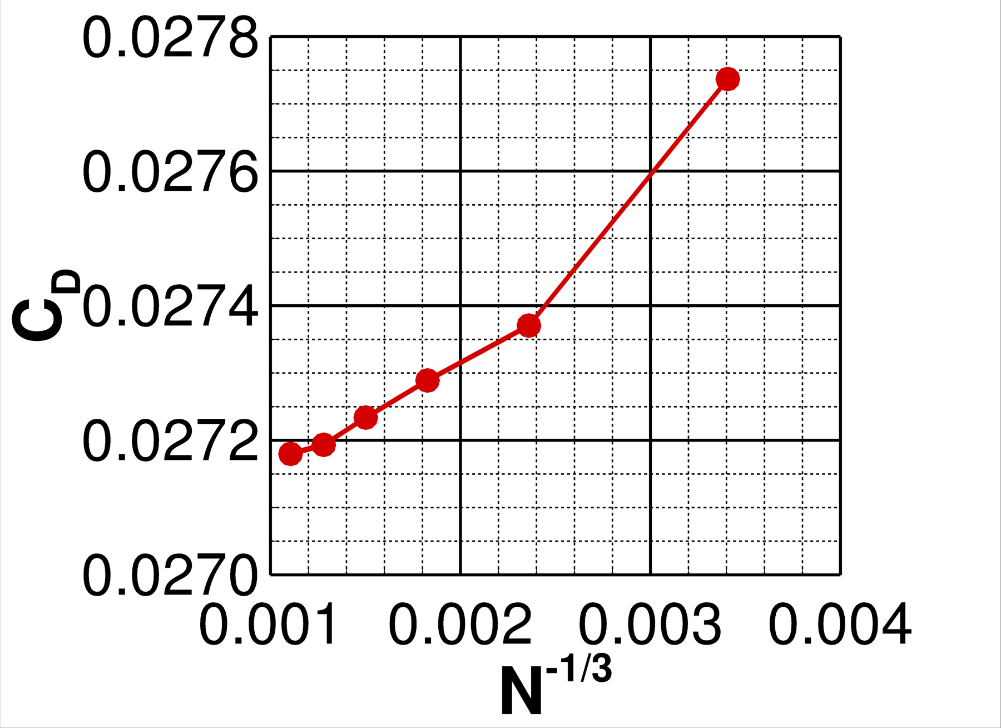
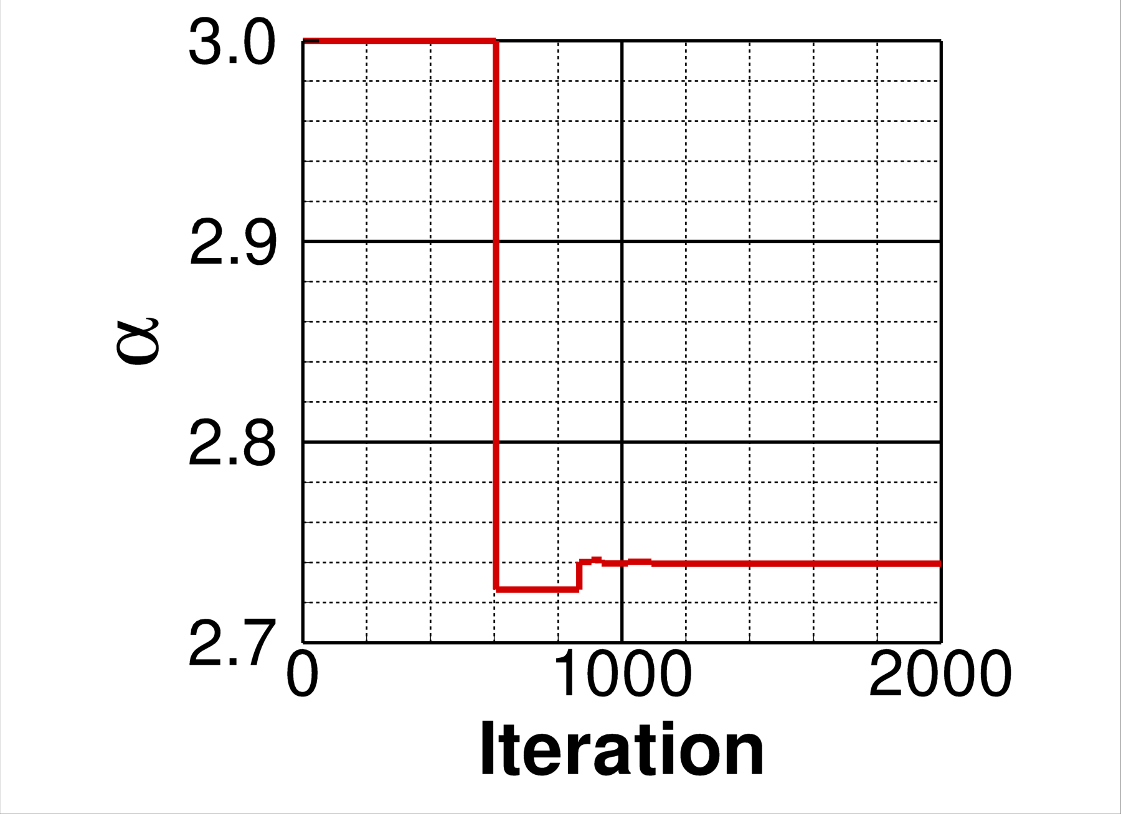
Case 1a: Grid Convergence
Simulations performed on all six grids
Rapid iterative convergence from HANIM methodology
Solution residuals reduced below 1.0E-13
Solution value taken at final iteration
Simulations performed in C_{L}-matching mode
Tolerance for C_{L} set at committee-specified +- 0.0001
Angle of attack perturbed automatically to match prescribed C_{L} within the tolerance limits
Angle of attack adjusted after residuals are reduced 1.5 orders of magnitude below the initial freestream state
(deg.)

Slide 9
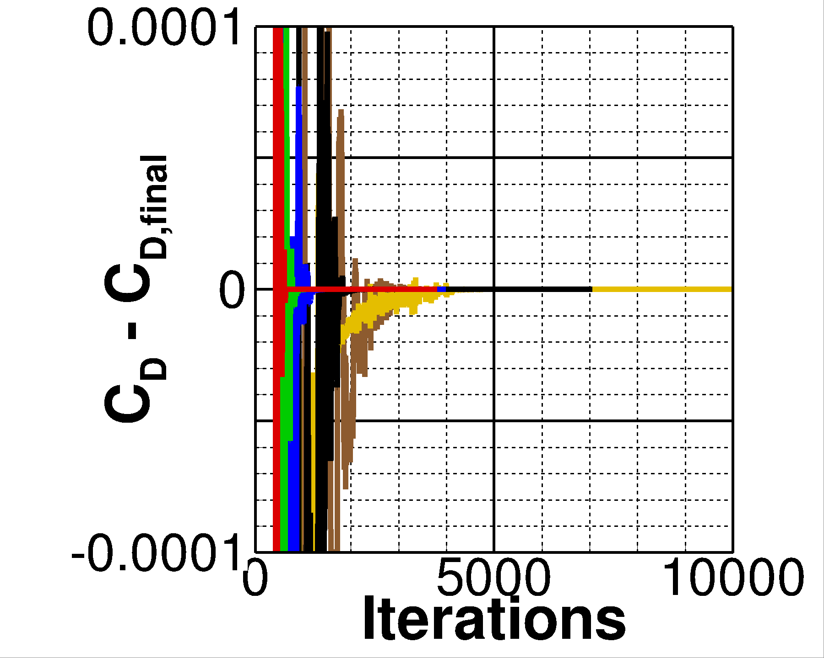
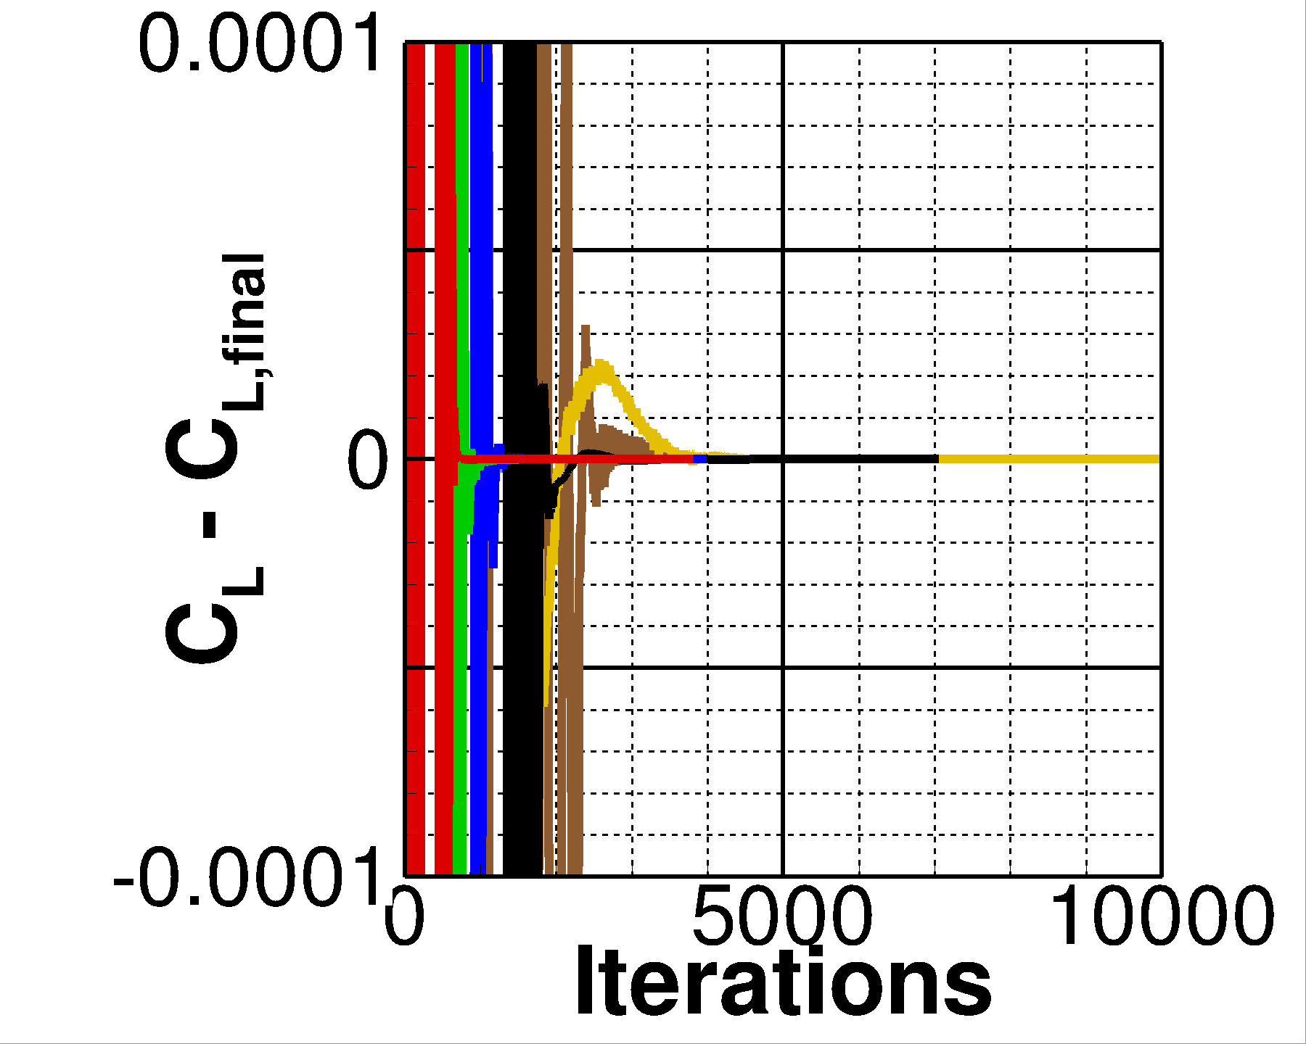
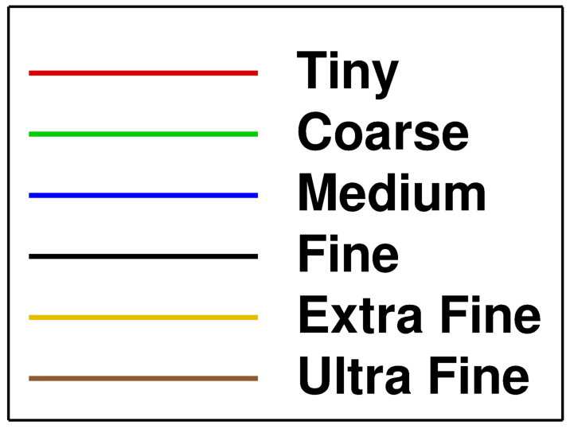
Case 1a: Convergence History
Convergence history monitored and stopped by the user
Drag has converged within six significant digits for all cases

Slide 10
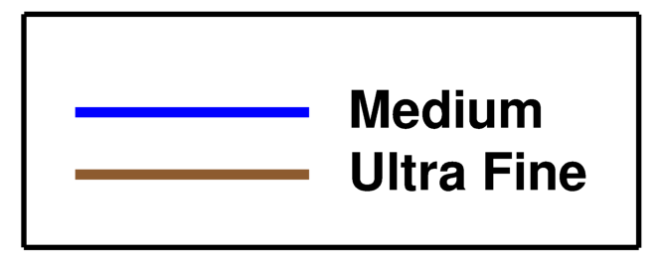
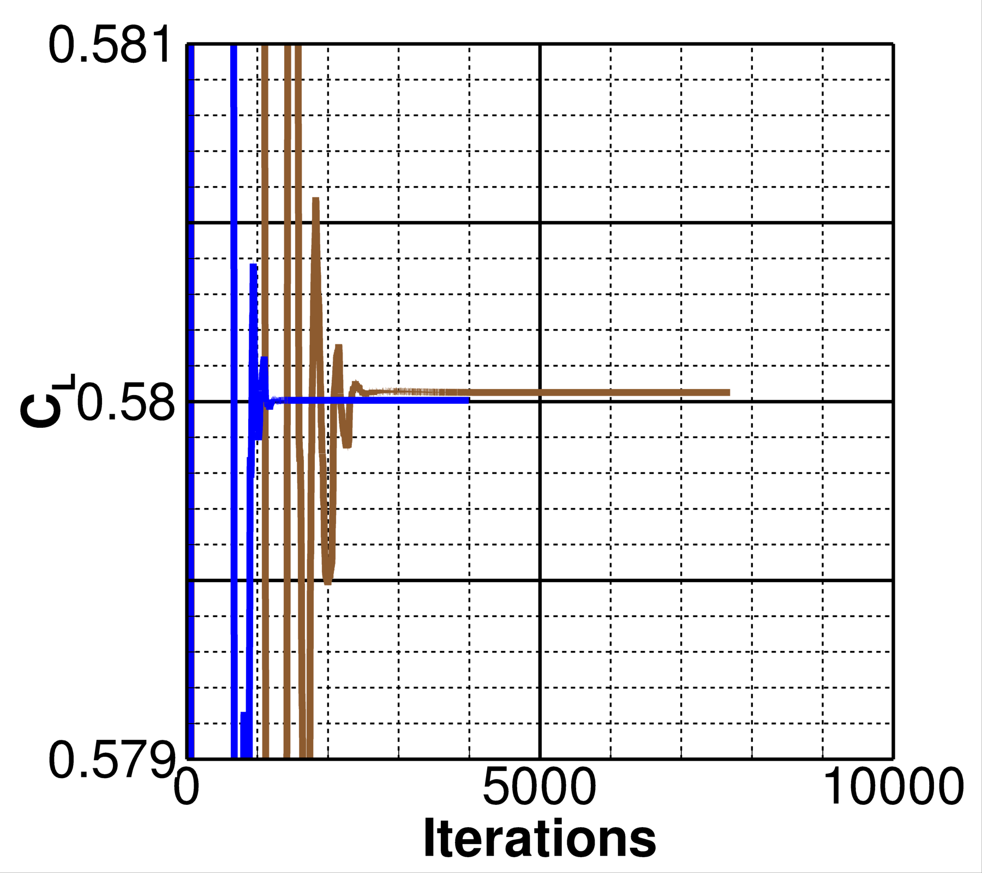
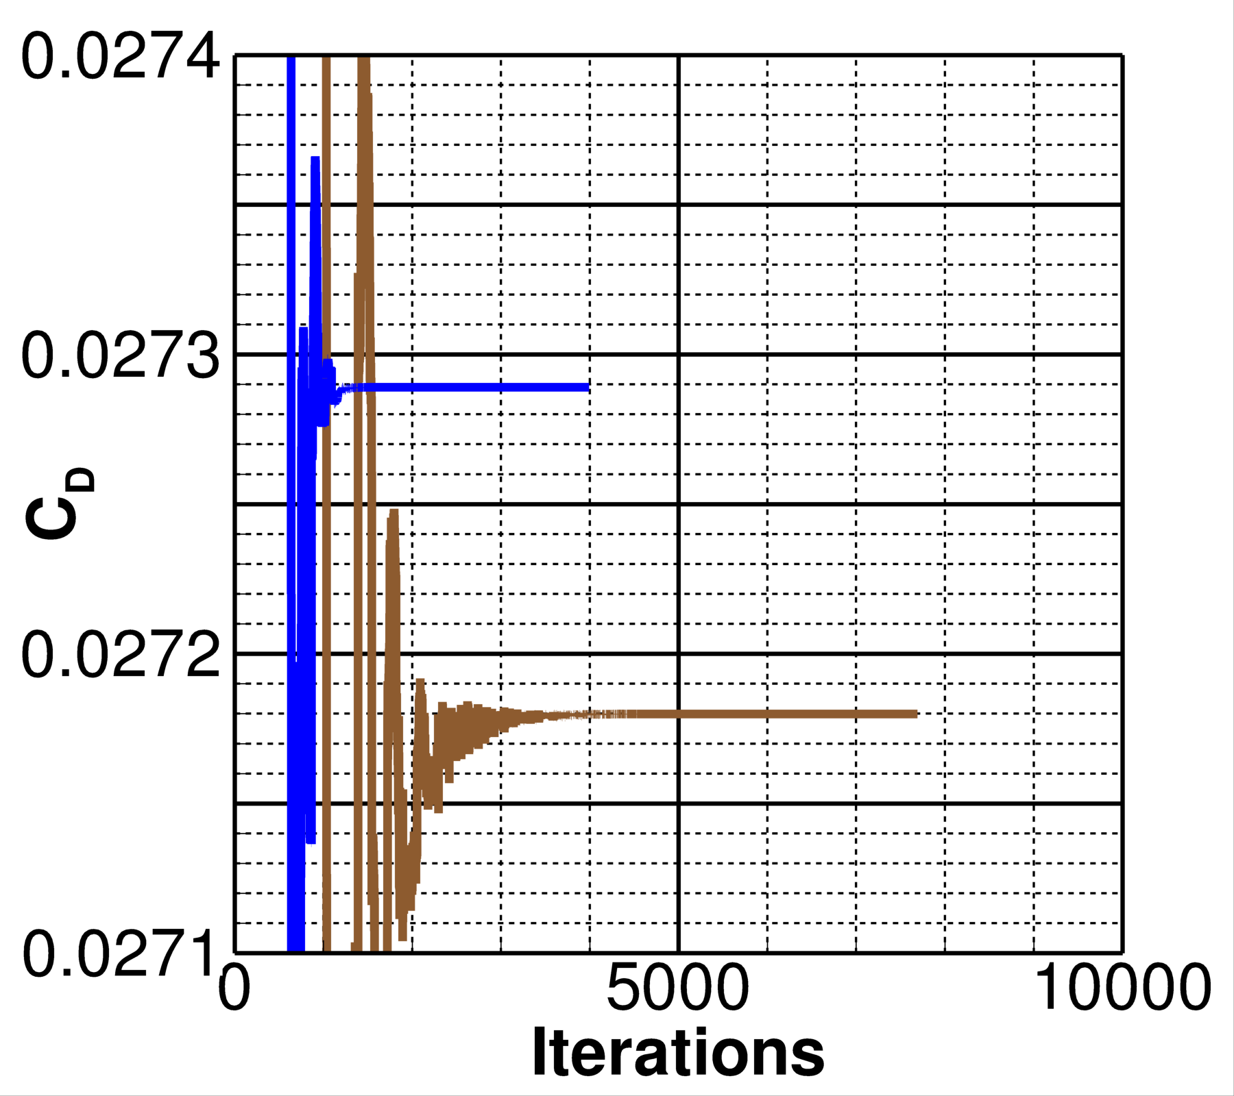
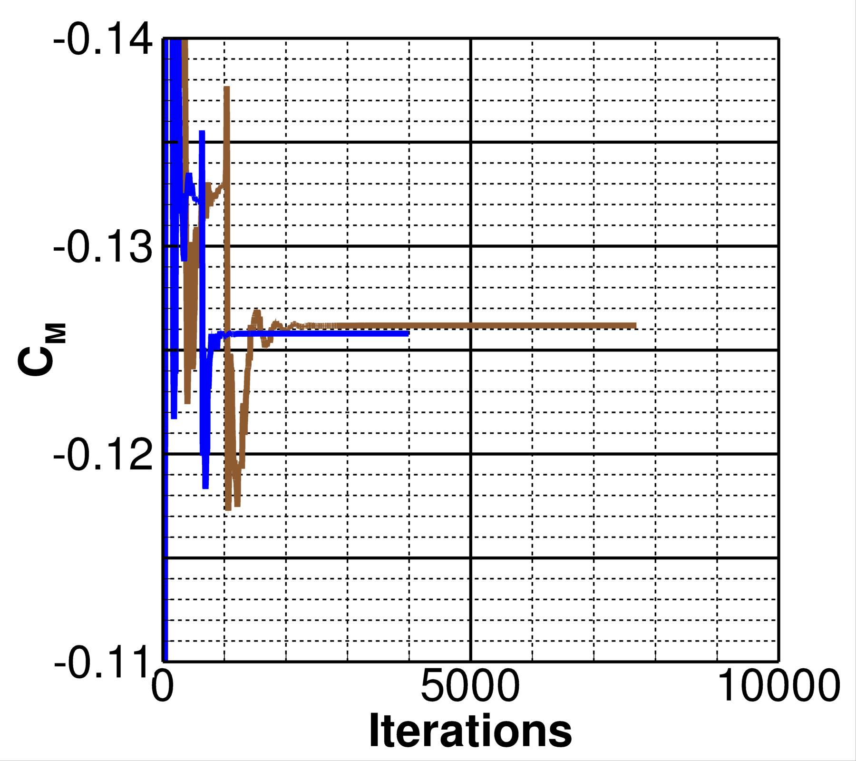
Case 1a: Medium and Ultra Fine Grids

Slide 11
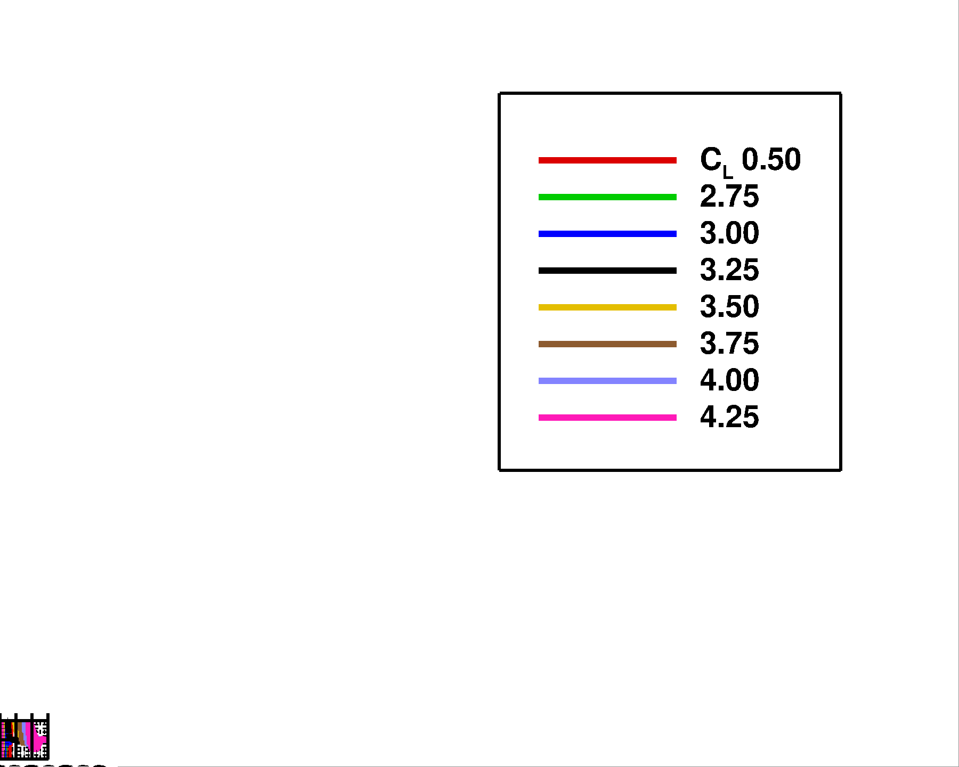
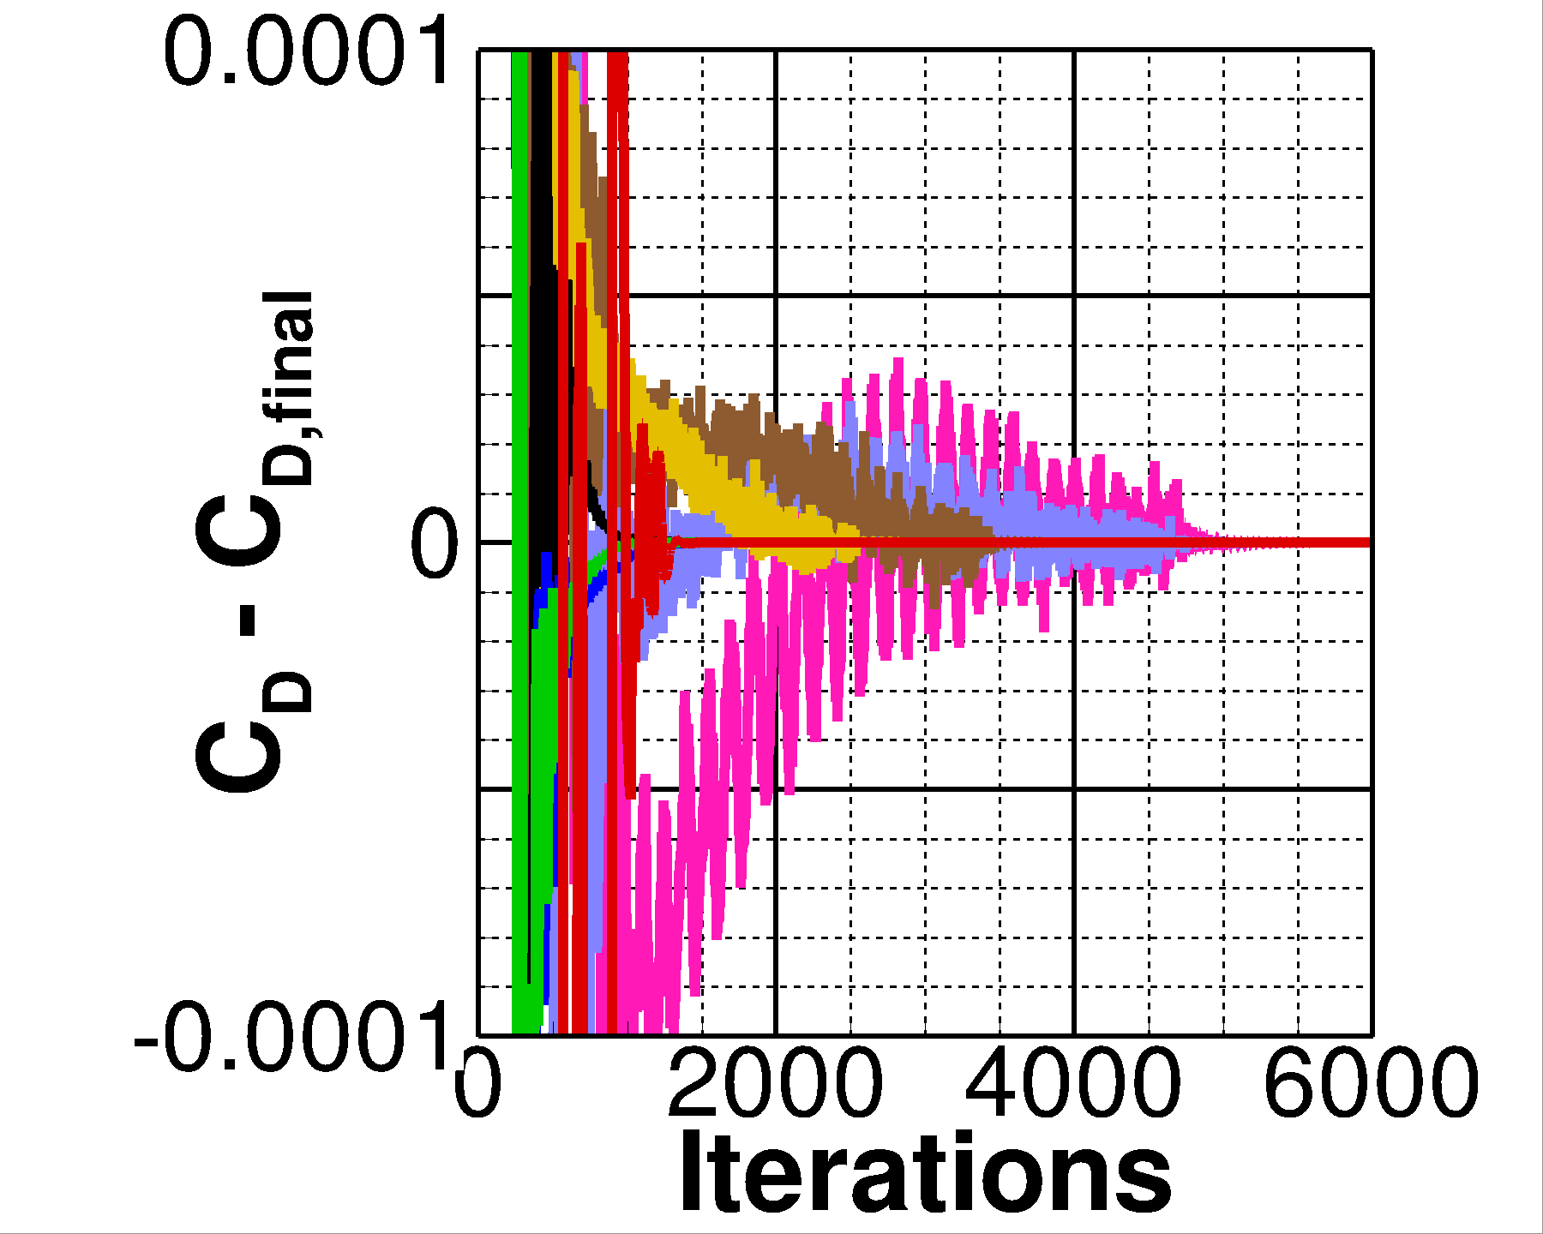
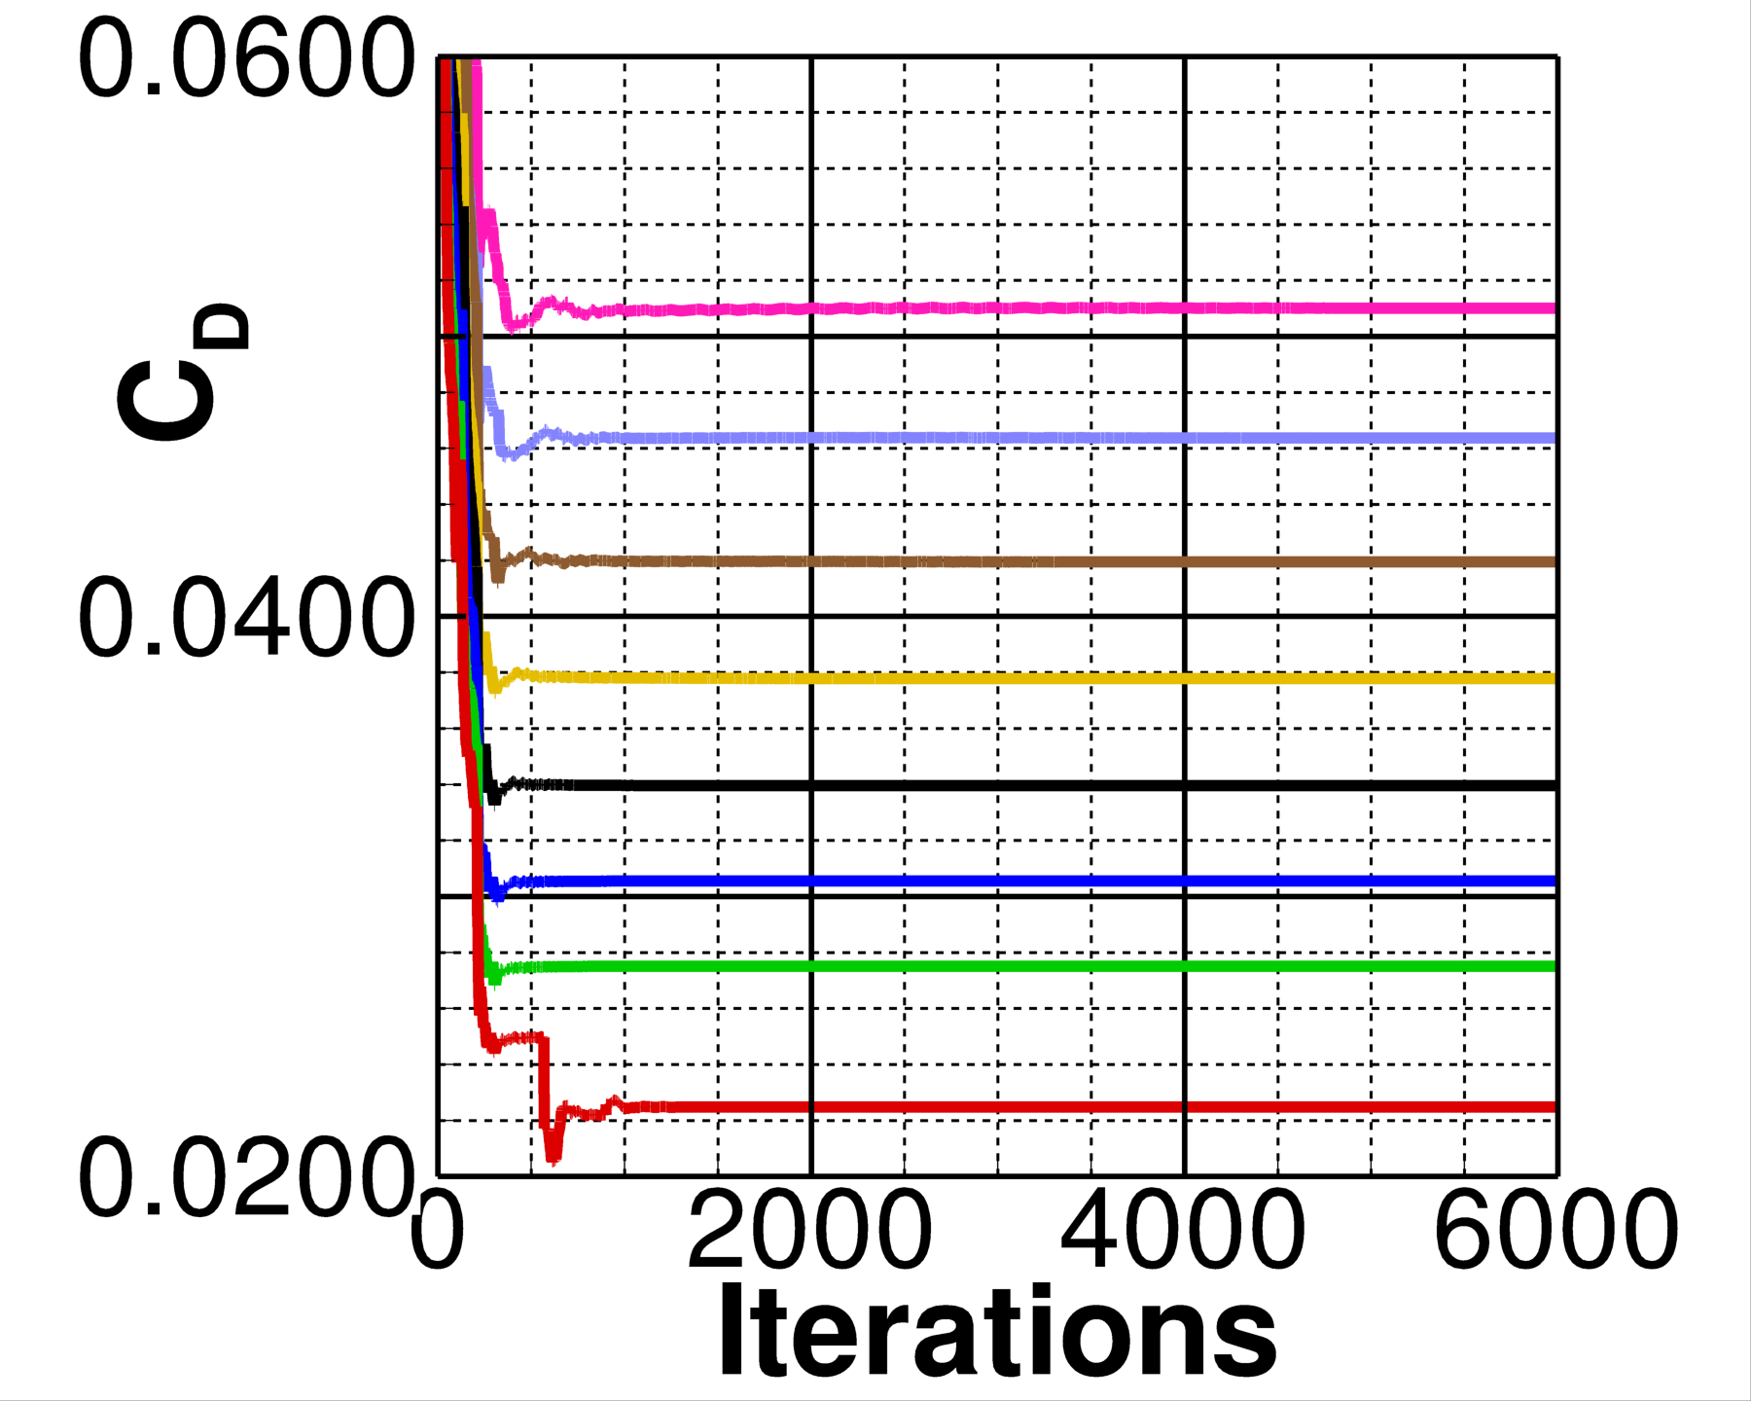
Case 2a: Iterative Convergence
Solution residuals reduced below 1.0E-13
Low-alpha cases converged in ~1k iterations
Converged solutions observed after 5k iterations for all simulations
deg.
deg.
deg.
deg.
deg.
deg.
deg.

Slide 12
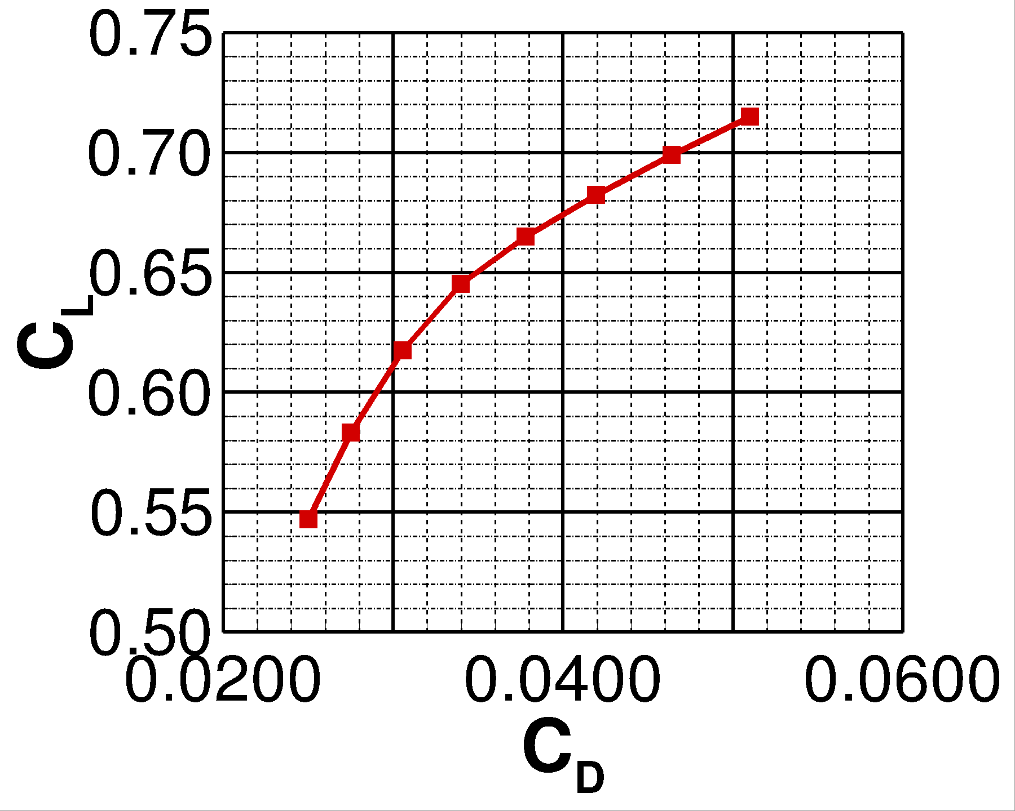
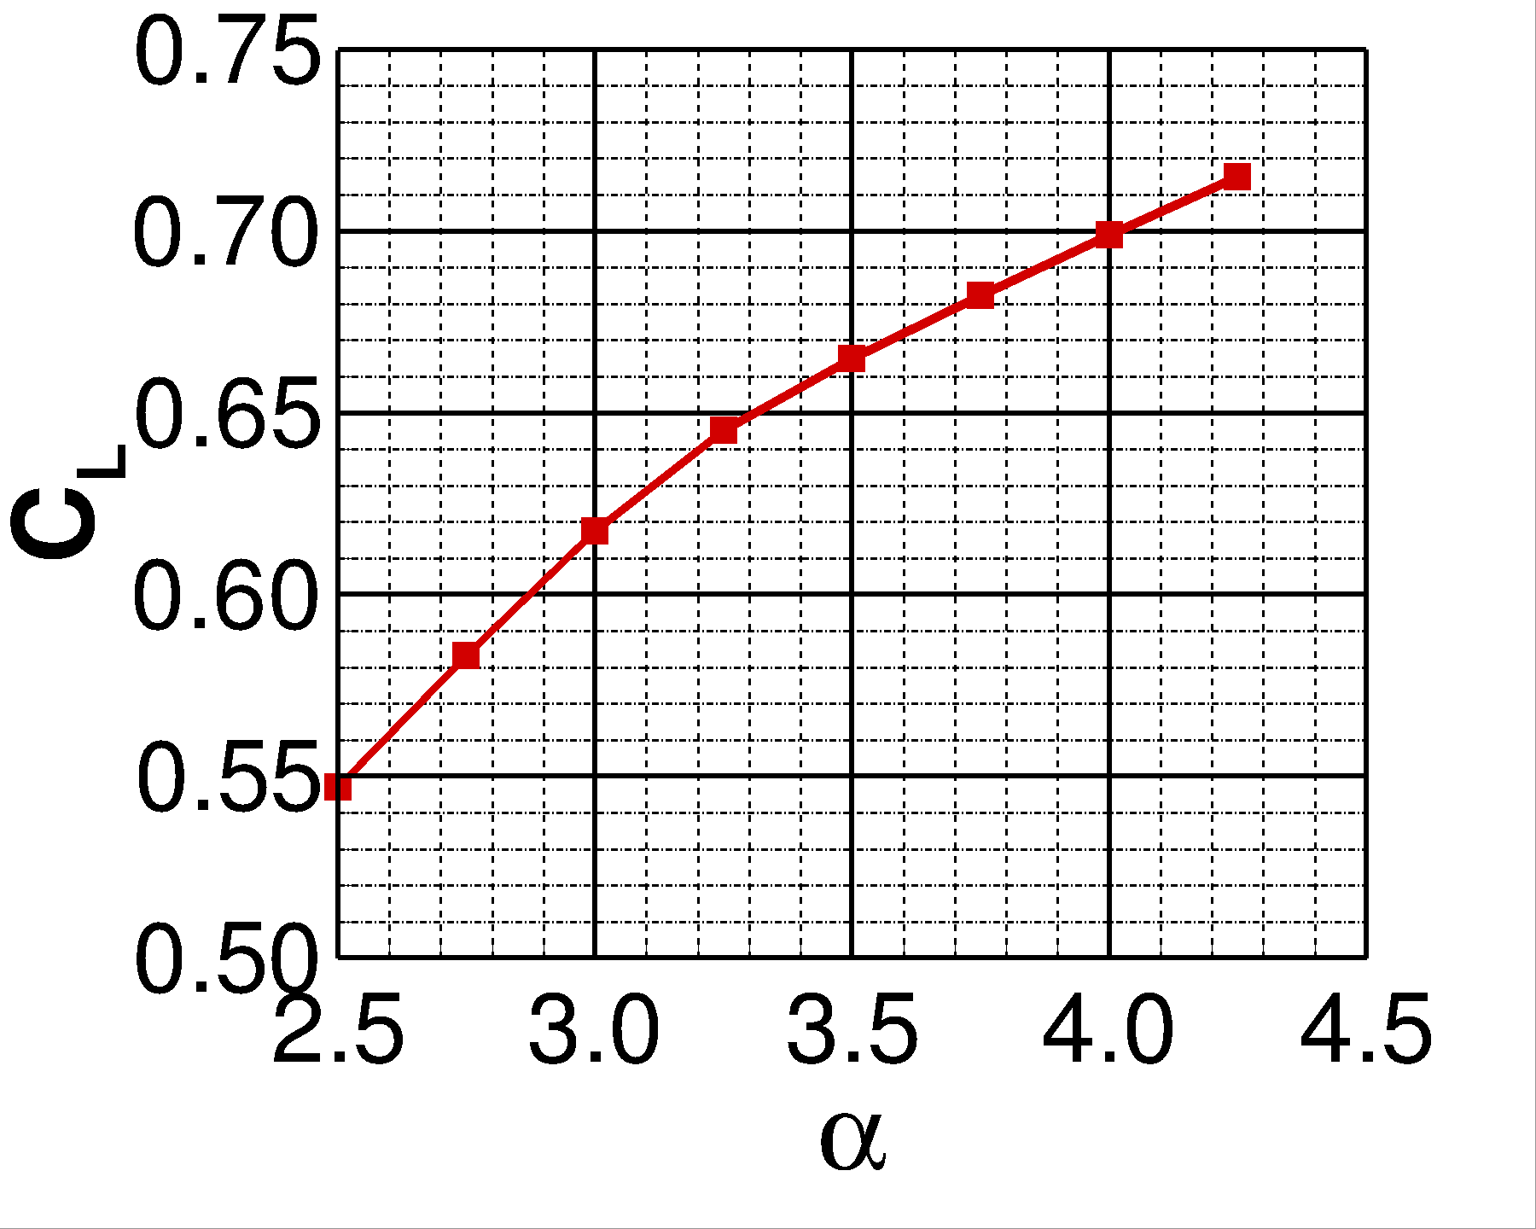
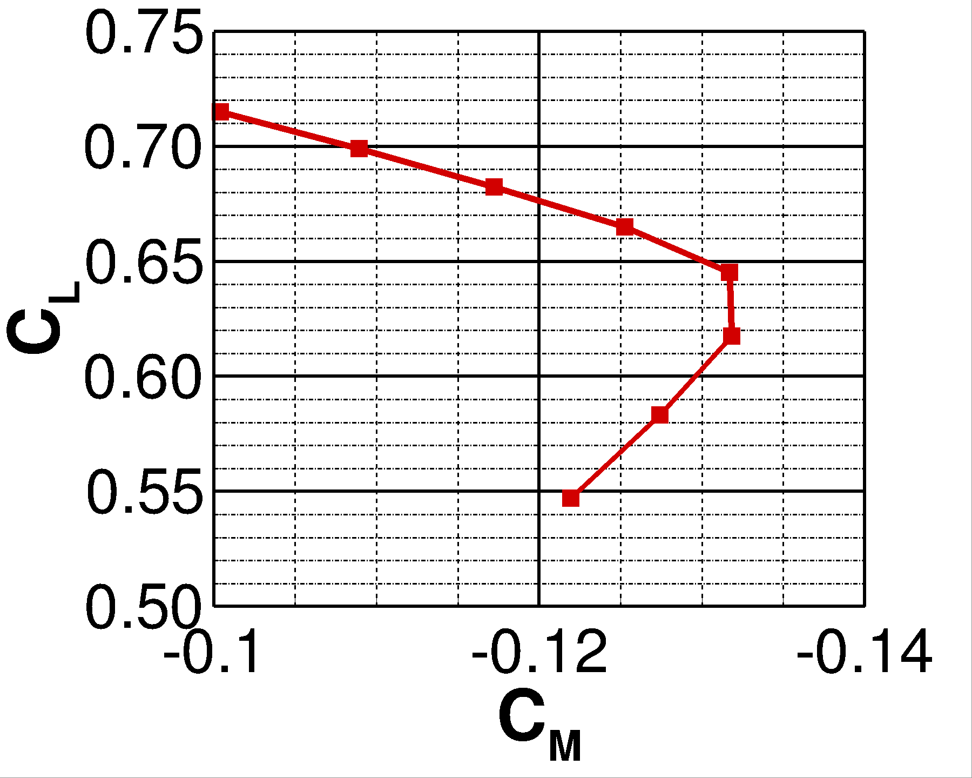
Case 2a: Aerodynamic Performance
Pitch break observed between C_{L} of ~0.62 and ~0.65 (3 to 3.25 deg.)
Bucket of pitching moment curve at C_{M} of about –0.133
(deg.)

Slide 13
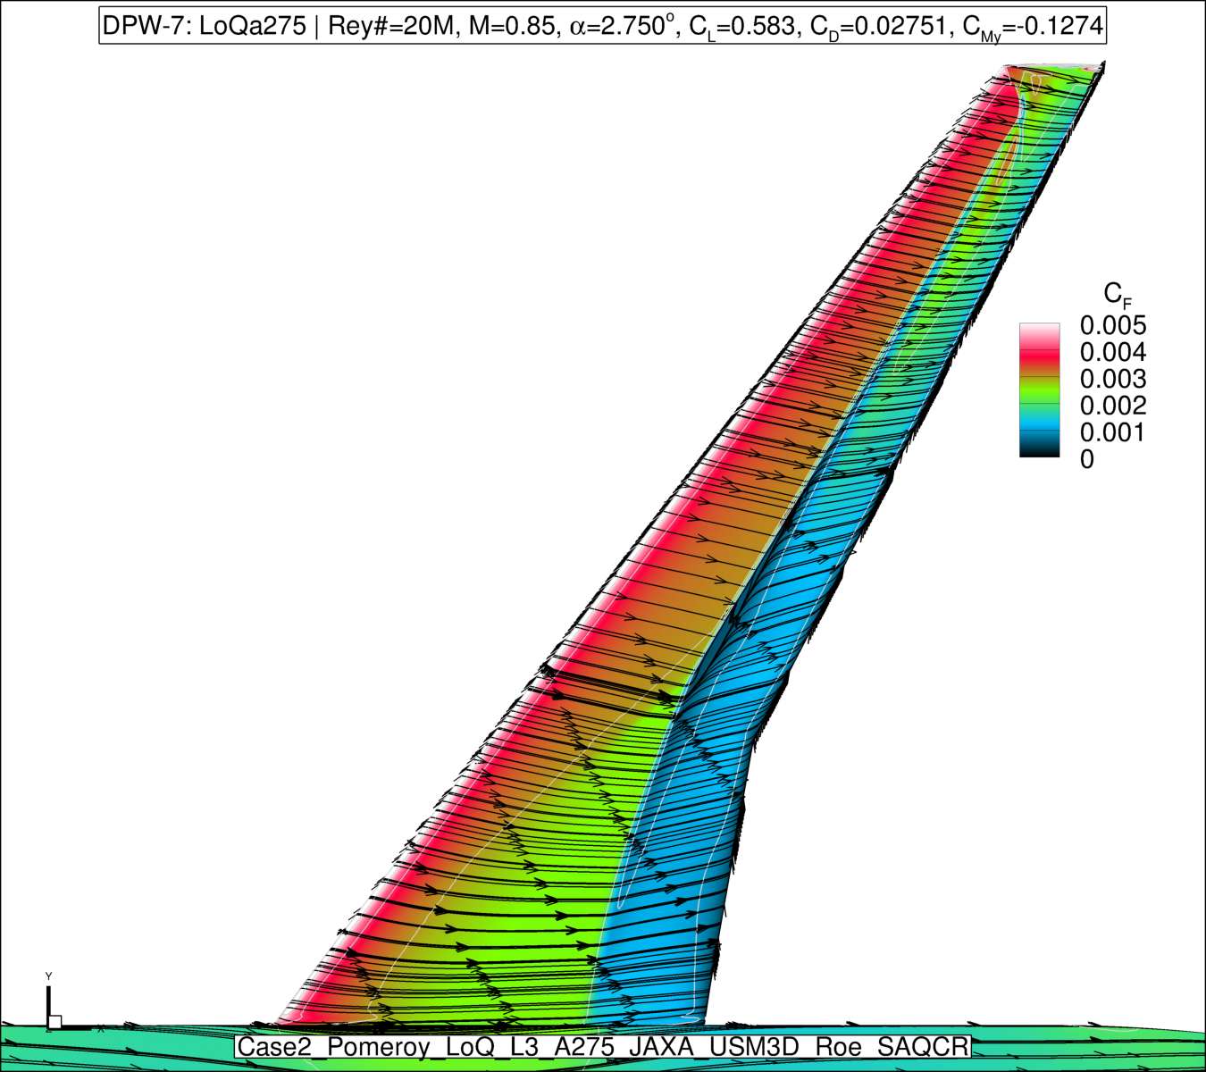
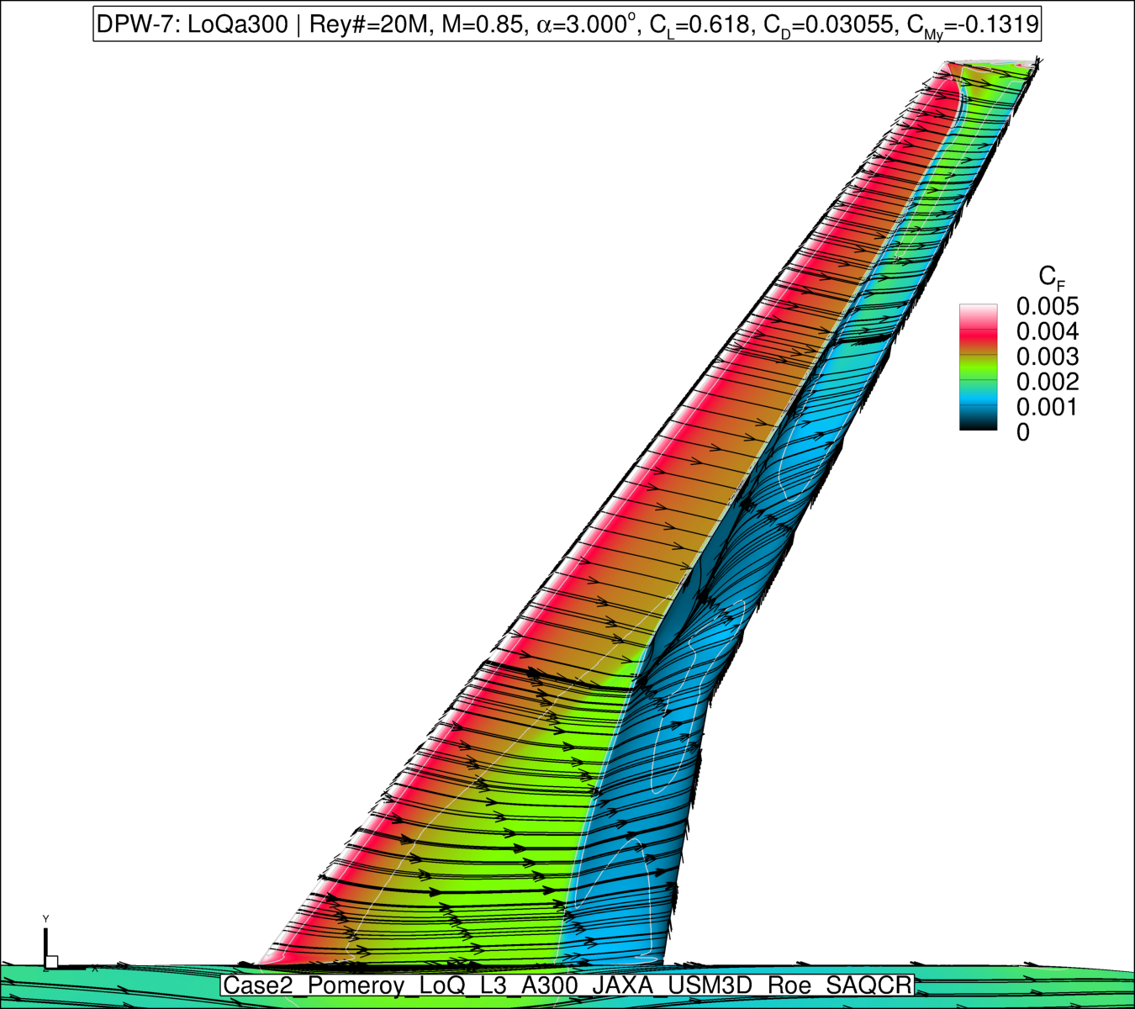
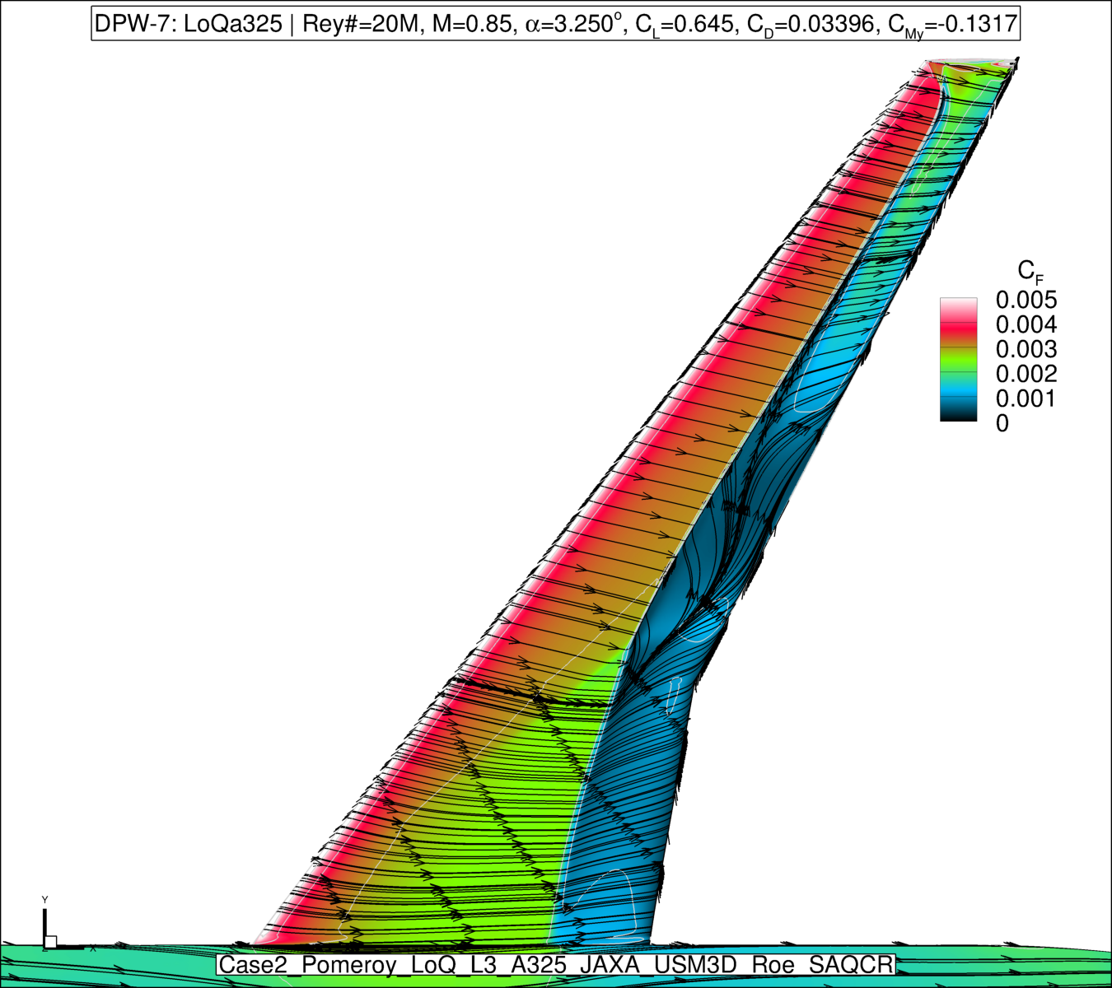
Case 2a: Surface Separation Behavior
Surface contours of C_{F} with streamlines
Shock-induced separation observed at 3.00 deg.
Midspan separation seen at 3.25 deg. (consistent with pitch break)
C_{L} = 0.583
Alpha = 2.75 deg.
C_{L} = 0.618
Alpha = 3.00 deg.
C_{L} = 0.645
Alpha = 3.25 deg.
Moderate
separation
Significant
separation

Slide 14
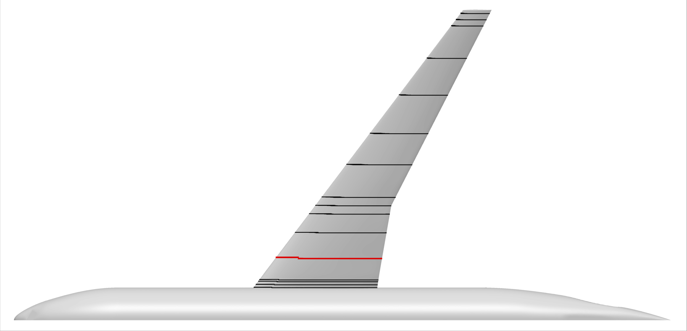
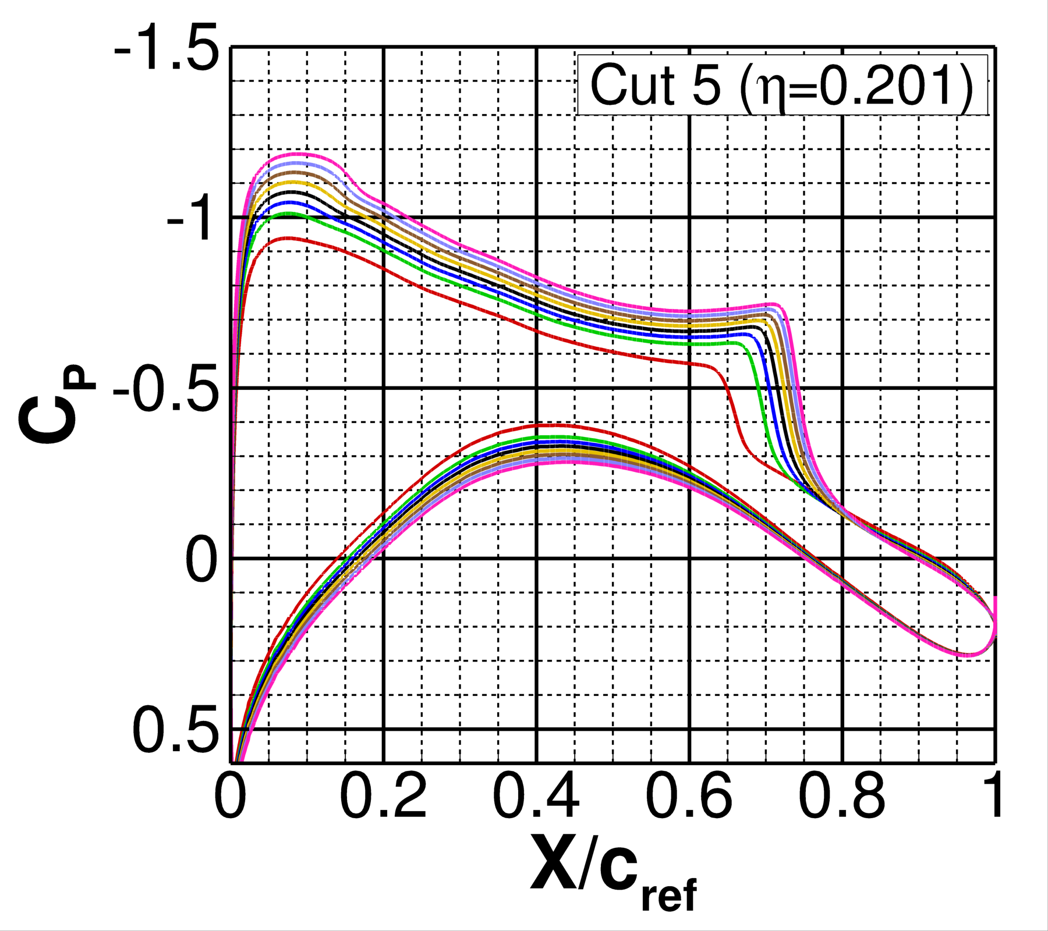
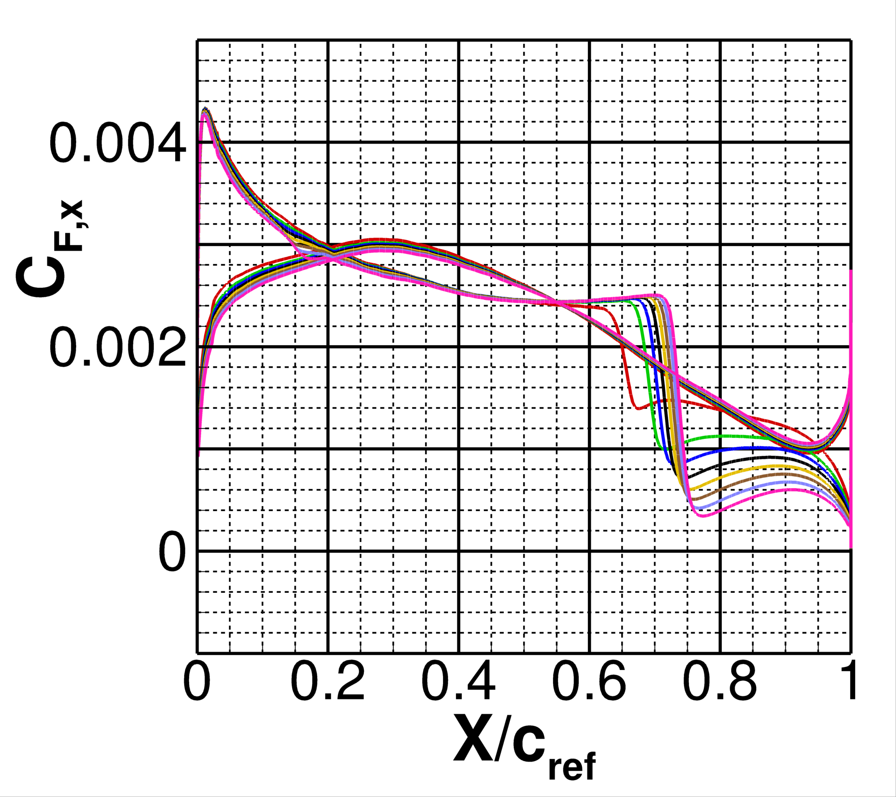
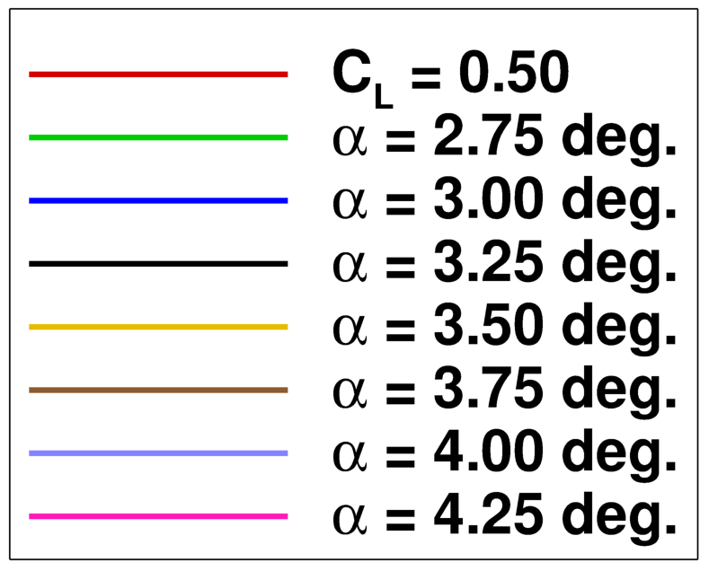
Case 2a: Inboard Surface Cuts
Cuts shown for the fixed-alpha conditions
Attached flow present across all simulations
Consistent with previous contour plots

Slide 15
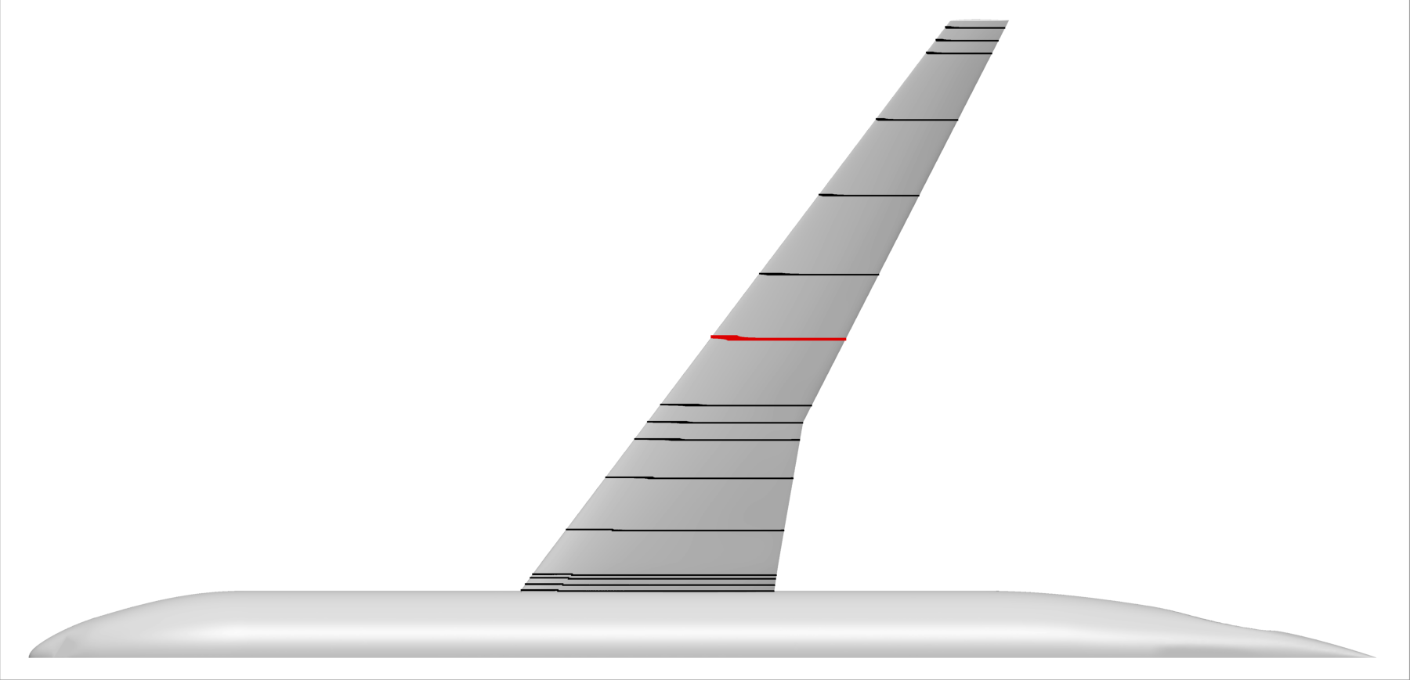
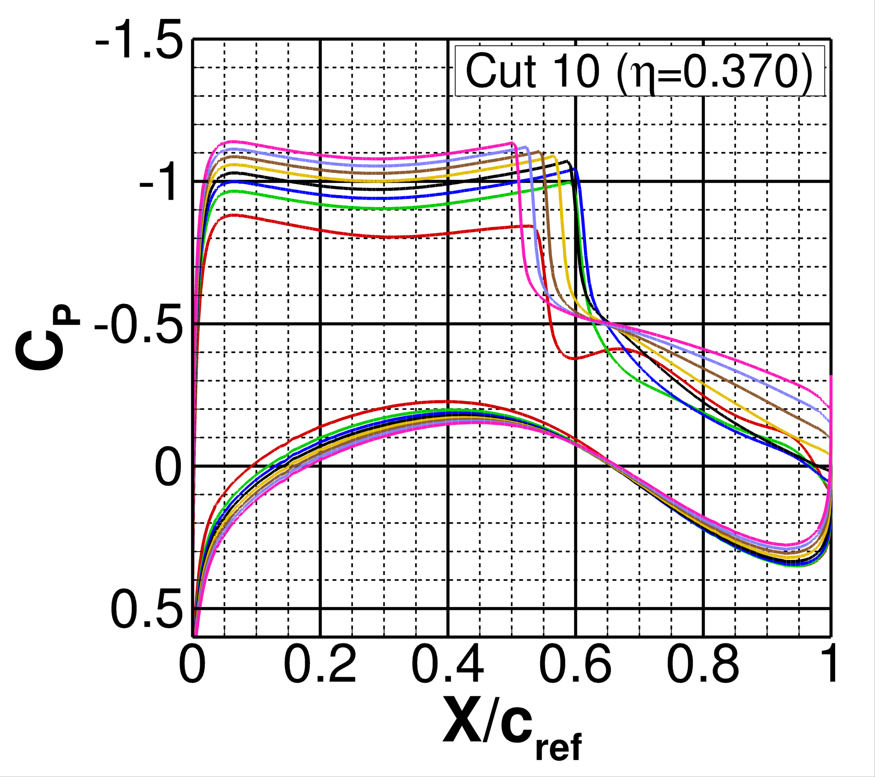
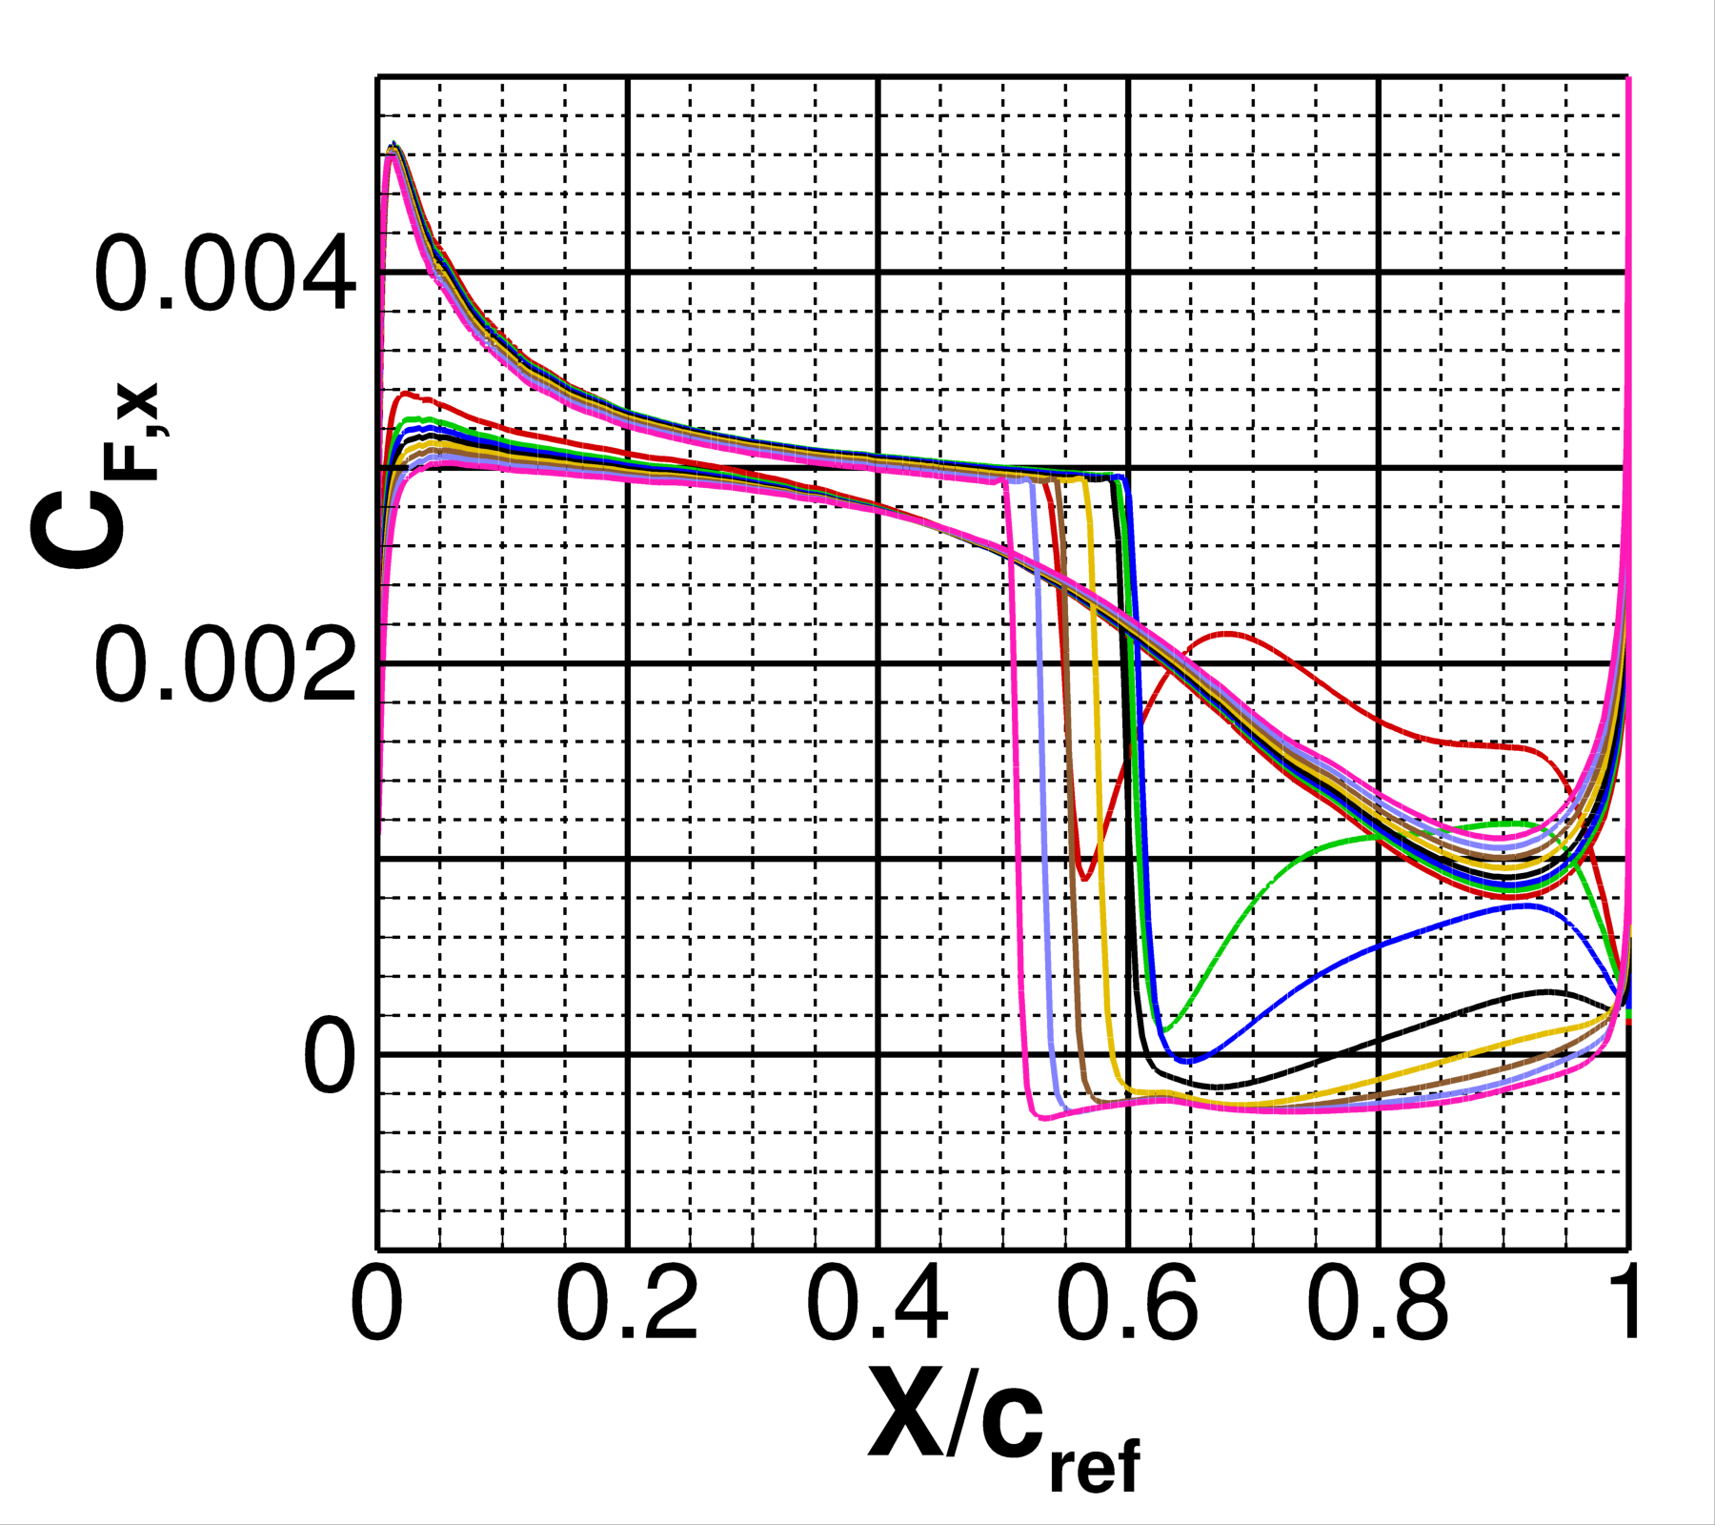
Case 2a: Mid-Span Surface Cuts
Region of earliest separation
Extent of downstream separation increases with larger alphas
Trailing edge flow separation for alpha above 3.00 deg.

Slide 16
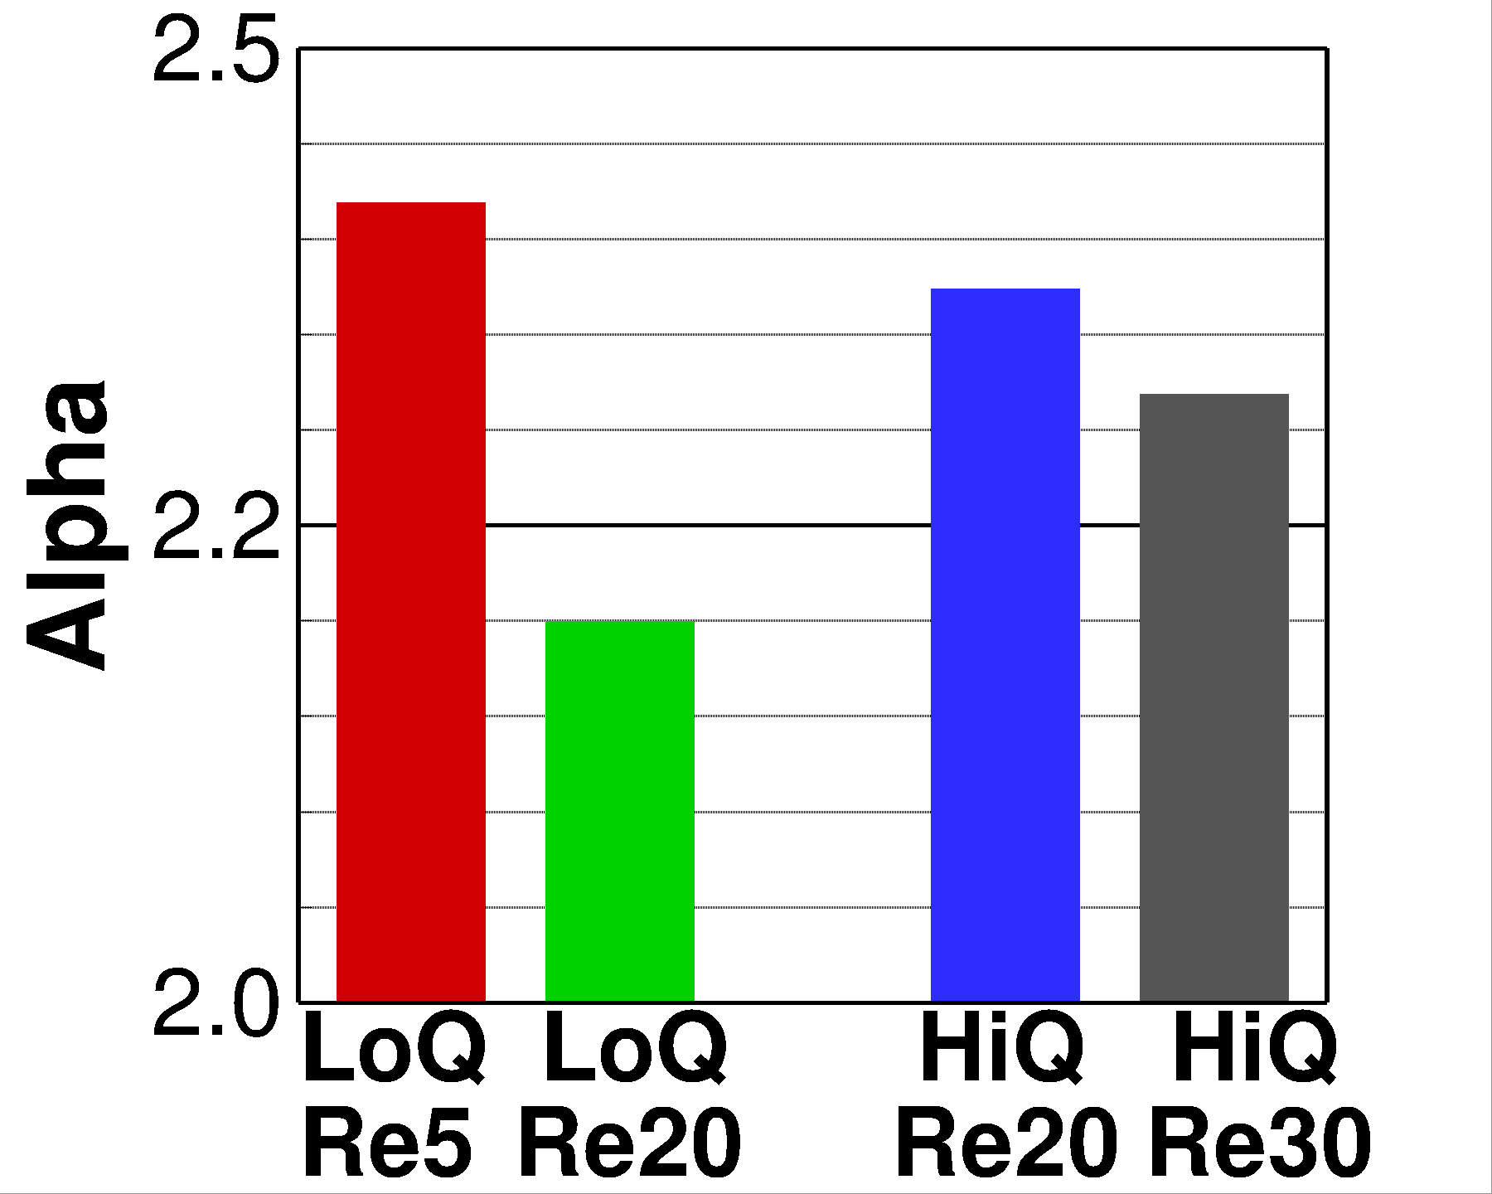
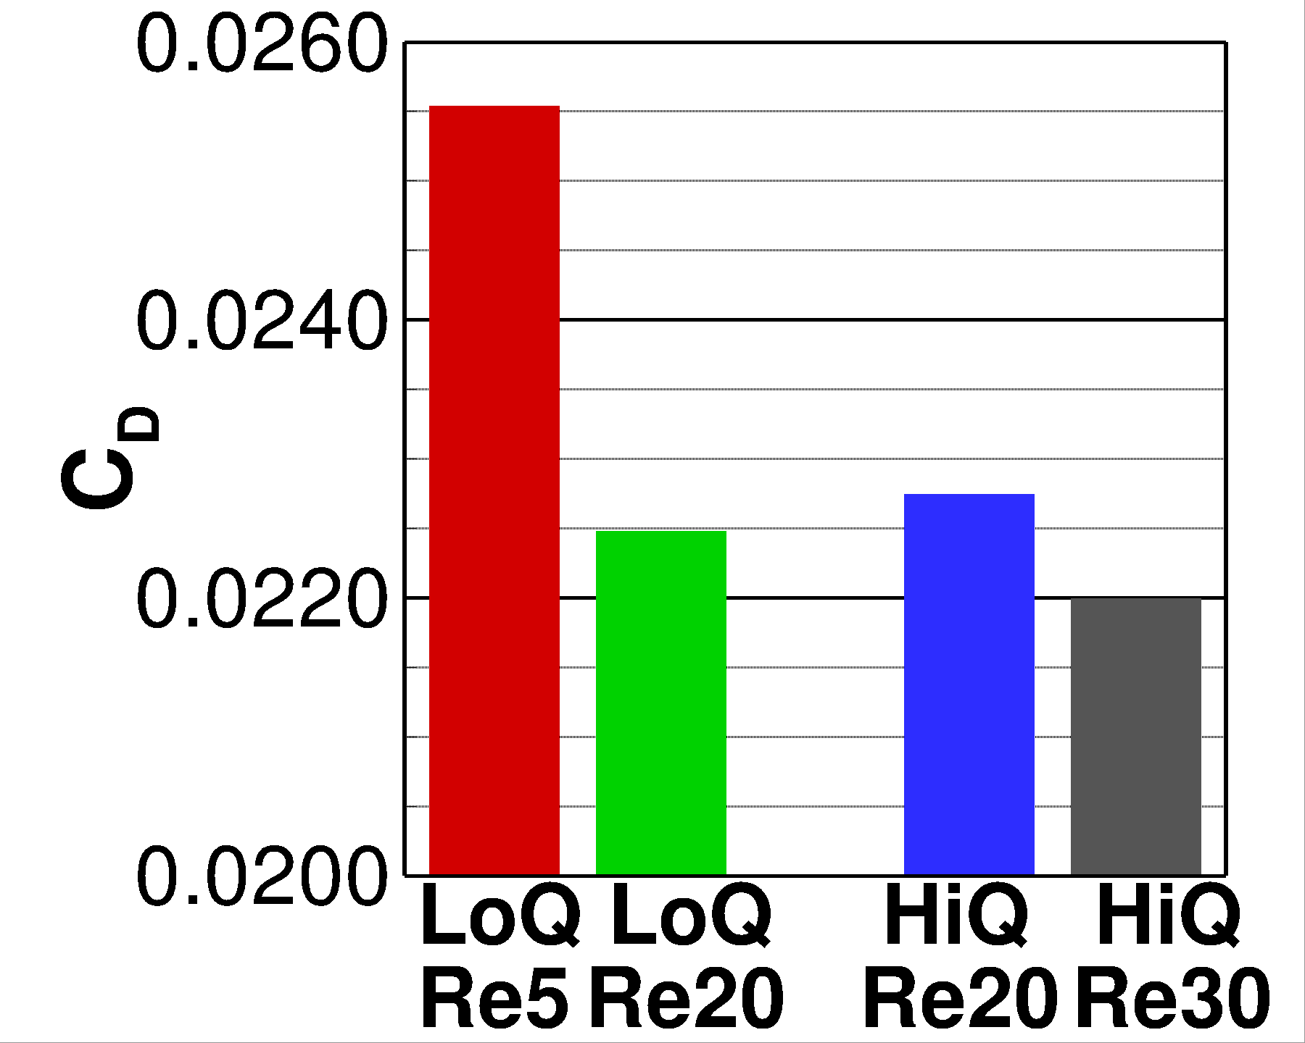
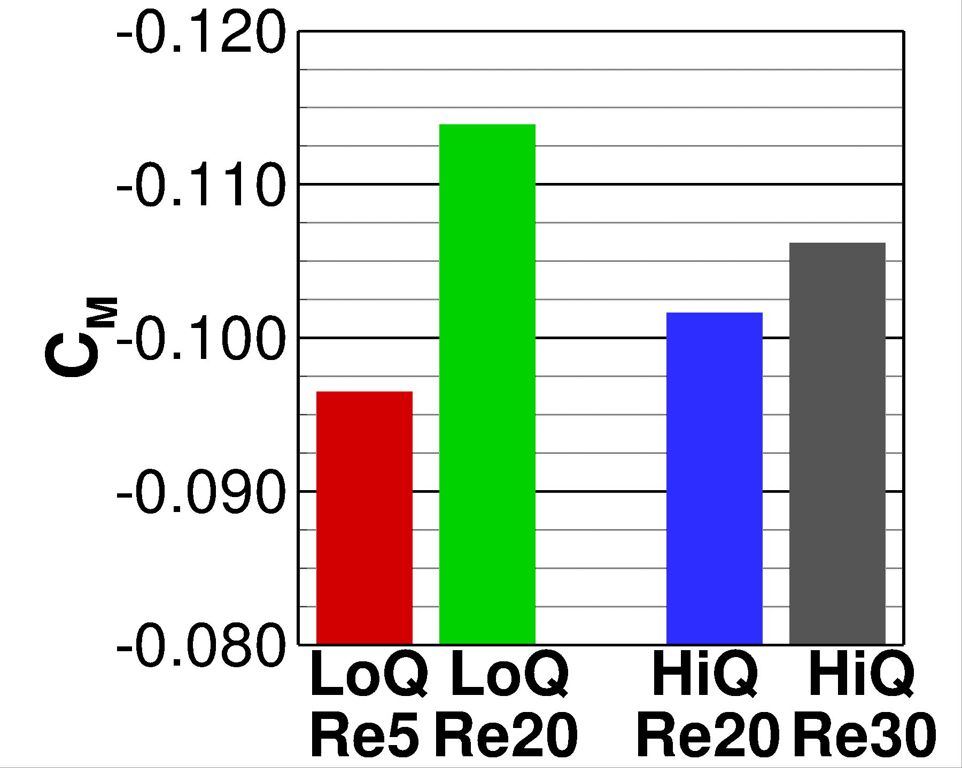
Case 3: Reynolds Number Sweep
Significant increase in drag for decreasing Reynolds number as the wing moves off design
Deviations in C_{M} ~0.016 between two 20 million cases (different conditions and lofts)
𝛼 (deg.)

Slide 17
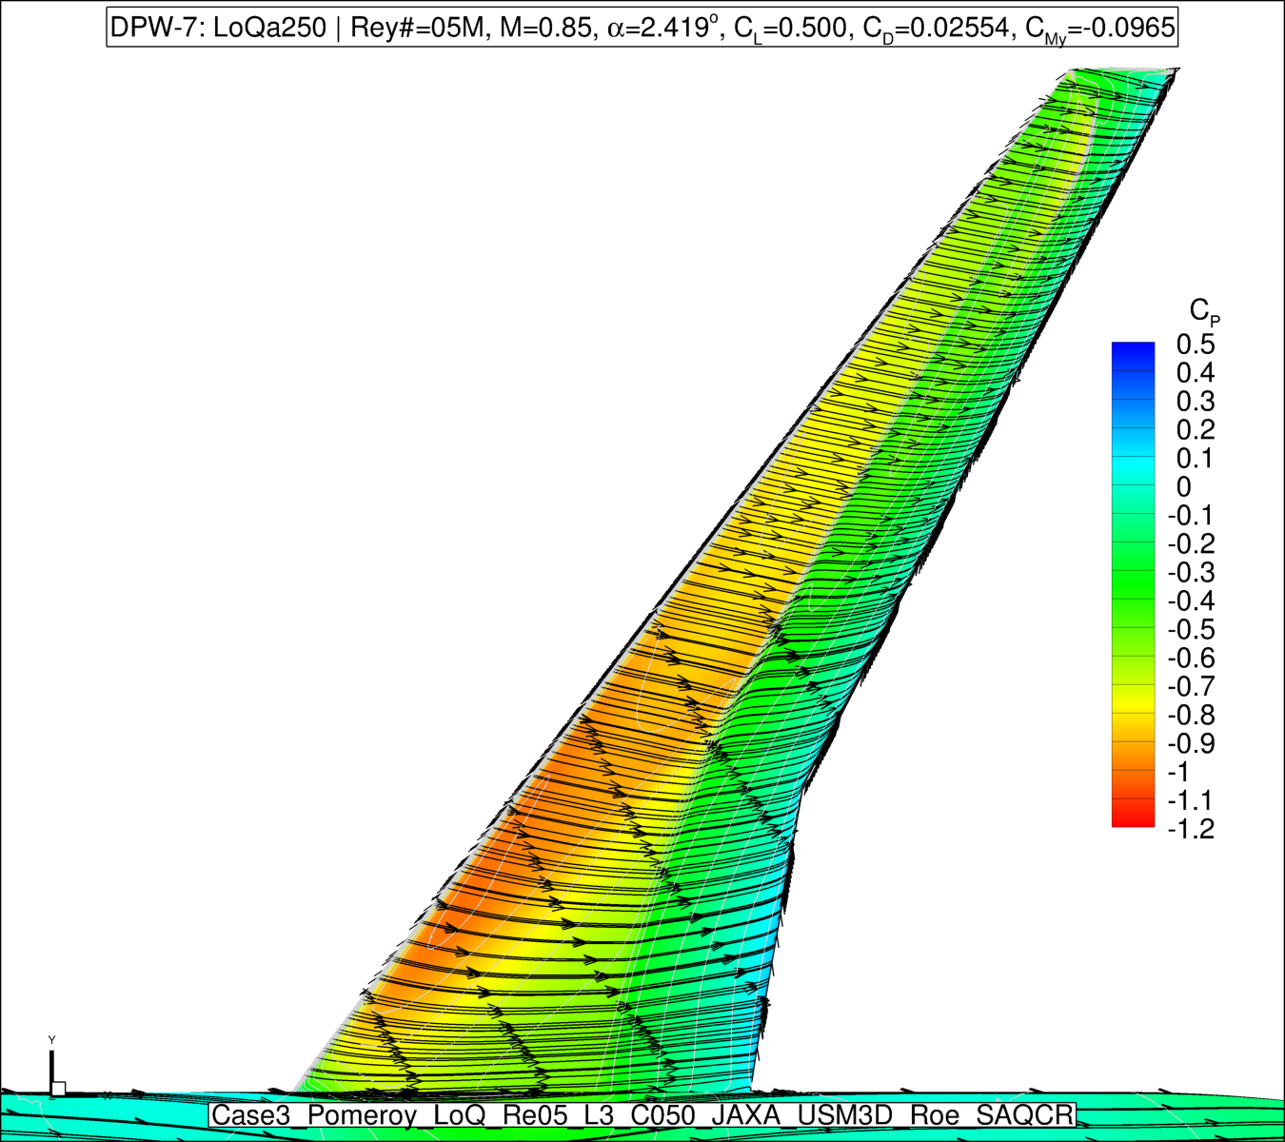
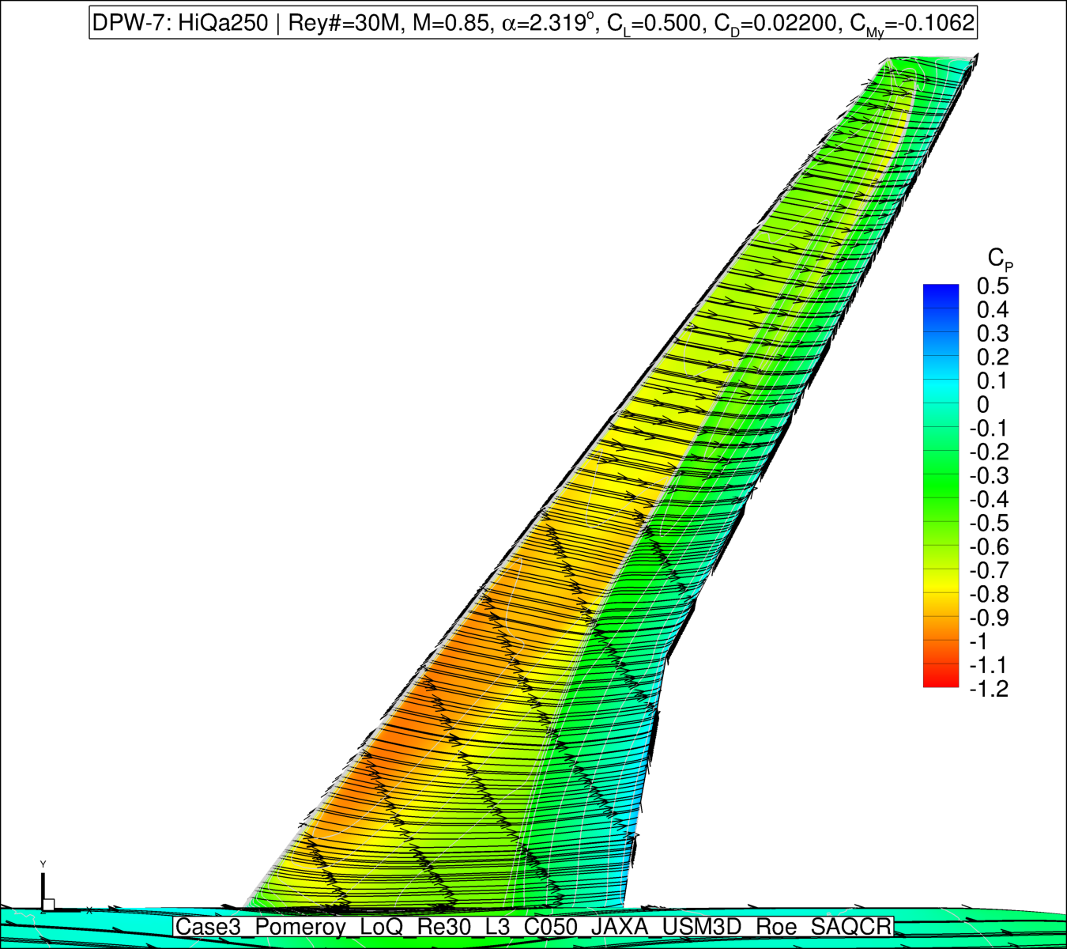
Case 3: Surface Pressure Comparison
Spanwise flow observed for low-Reynolds number case
Re = 5 million
Re = 30 million
Midspan spanwise flow

Slide 18
Conclusions
USM3D-ME results for cases 1a, 2a, and 3 presented
Rapid convergence to machine-zero residuals achieved (less than 1,000 iterations for some cases)
Strong grid convergence across all six JAXA grids
Pitch break at C_{L} ~0.62 (alpha ~3.15 deg.)
Committee-required data files previously provided

Slide 19
Acknowledgments
NAS for compute facilities
Appreciation extended to the DPW-7 workshop committee for providing grids, the data format, and data reduction scripts

Slide 20
